Slide 1


Air Force Institute of Technology
NENG 791 – Proliferation of Weapons of Mass Destruction
Uranium Enrichment Technologies
LTC Buck O’Day
E d u c a t i n g t h e W o r l d ’s B e s t M i l i t a r y

Slide 2
Outline Overview of Uranium Enrichment Technologies
Methods of Uranium Enrichment Preview
The Isotope Enrichment Stage
Isotope Enrichment Cascades
Separative Work
Method of Uranium Enrichment
Gaseous diffusion
Gaseous centrifuge
Thermal diffusion
Electromagnetic separation
Aerodynamic separation
Chemical processes
Laser isotope separation
We won’t have time to go over all the slides in class but you need to go through them on your own. I have “hidden” some slides but you are still responsible for them. I don’t plan to go over them in class but we can as needed.
Notes:
Which of the enrichment methods are current production methods, legacy methods (previously used but now retired), and prototype methods?
Current—gaseous centrifuge, Laser Isotope Separation (SILEX-separation of isotopes by laser excitation), gaseous diffusion
Legacy—electromagnetic (calutron), aerodynamic nozzle
Prototype methods—AVLIS, Chemical separation

Slide 3
Objectives
Better understand the nuclear fuel cycle
Better understand the technical aspects of the pathways to uranium enrichment
Note that much of the material cited for the different enrichment methods comes from “Nuclear Forensic Analysis” (2nd Ed) by Moody, Grant, and Hutcheon. This is a great book you may want to consider adding to your professional library.

Slide 4
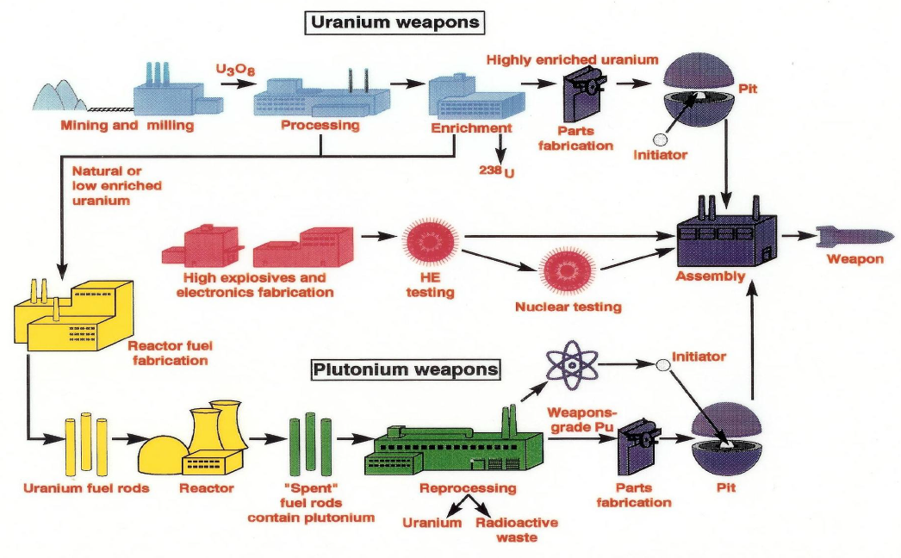
The Fuel Cycle: Weapons Specific
Notes:
We’ve already covered this slide. I include it here so you know how this lecture relates to the fuel cycle blueprint.
We’ll concentrate this lecture on Uranium enrichment.
This would fit into the “enrichment” stage in the top row of the graphic and the “reprocessing” stage of the bottom row of the graphic.

Slide 5
Uranium Enrichment
Separation based on chemical, isotopic, or physical (mass) differences.
Natural Uranium is ~ 0.72% ²³⁵U.
Demonstrating the capability to enrich Uranium to 0.73% demonstrates the ability to enrich to WGU
Keep in mind that a process that does allow enrichment may not necessarily be practical
As the enrichment increases that amount of material for a critical mass decreases
Notes:
Basically, enrichment is increasing the fraction of a desired isotope.
Why does enrichment of material decrease the amount of the material required for a critical mass?
To answer this, you can think about the cross sections (fission and absorption-non-fission) for 238U and 235U
Can you define the following terms? (Expect to be asked what these terms mean throughout the lectures. It’s the vernacular so you need to know the terminology)
assay, enrich, deplete (strip), LEU, HEU, Feed, Product and waste

Slide 6
General Definitions
Assay: % uranium isotopes that are ²³⁵U
Enrich: increase assay
Deplete (strip): decrease assay
Low-enriched Uranium (LEU): < 20% ²³⁵U
Highly enriched Uranium (HEU): > 20% ²³⁵U
Feed: U processed by separator
Product (Heads): enriched uranium produced
Waste (Tails): depleted uranium produced
Notes:
Here are some general definitions you will want to be familiar with.
Note the term HEU here. Often times, especially with policy makers, people confuse HEU with WGU.
Can someone explain the difference between HEU and WGU?
What are the three major steps to acquisition of a nuclear weapon?
Acquisition, Integration of high-explosive components, and integration of a delivery system.

Slide 7
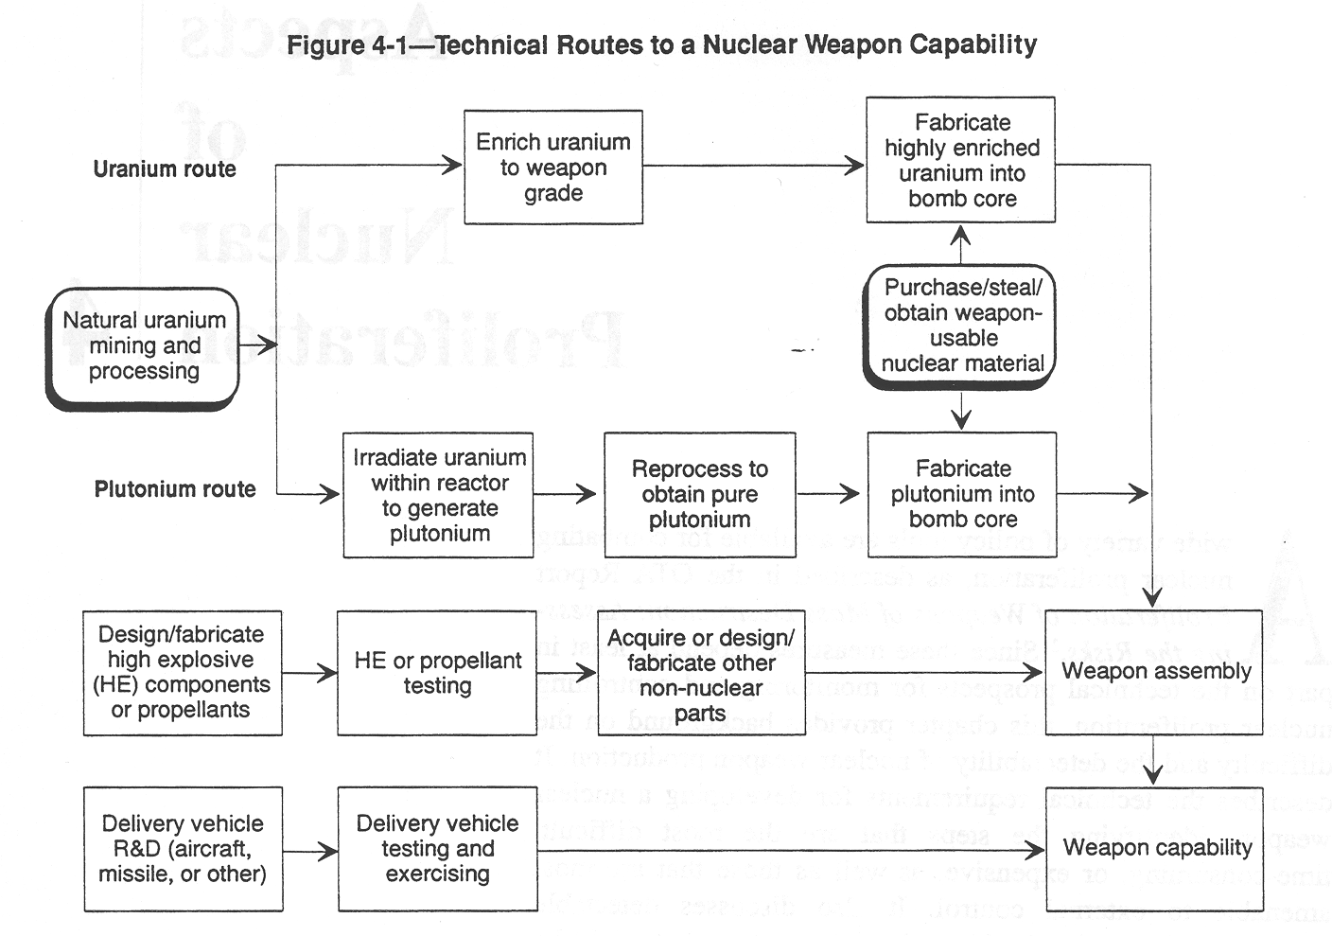
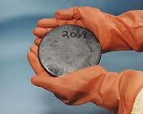
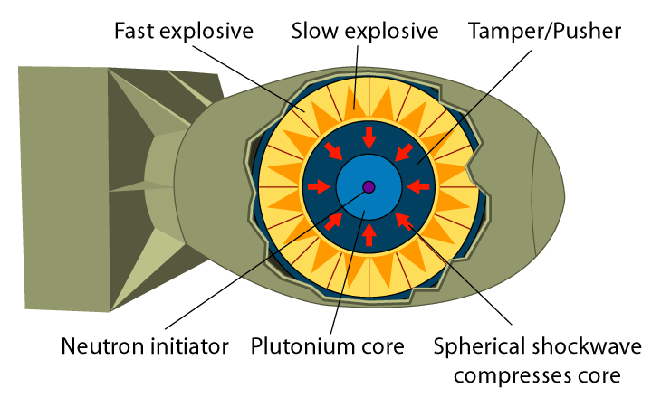
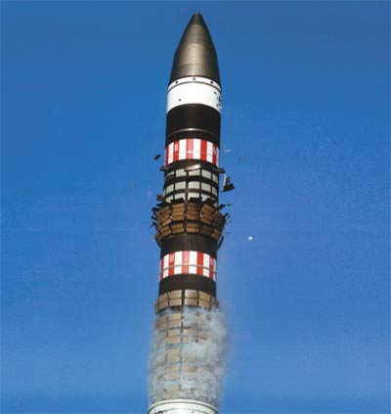
Technical Routes to a Nuclear Weapon
1
2
3
Major Steps
Obtain special nuclear material
Integrate high explosive components
Integrate delivery system
Notes:
Here is your first introduction to the “Technical Routes to a Nuclear Weapon”
Note the major steps.
(1) Acquisition of SNM. How can you make
Note that If you are able to purchase, steal, or otherwise obtain weapon-usable nuclear material you have bypassed a significant amount of effort.
If you are able to obtain the SNM in enriched form, you still have to turn it into the form needed for a weapon.
(2) Integration of high explosive components.
Is it easier to make a gun-type or an implosion weapon?
For this phase, creation of a gun-type weapon is much easier than creation of an implosion type device.
(3) Integration of a delivery system. Depending on what you want to do, this can be very difficult (say placement in an ICBM) or quite easy (placement in a moving truck or connex)
Traditionally we say that step (1) is very, very difficult. However, if you are able to “steal” the SNM (especially if it is in enriched form) you reduce the scale of the problem significantly.
How do steps (2) and (3) differ depending on what the intent is for use of the weapon?
Obviously, building a weapon for placement on a warhead has different requirements (much more difficult) than building a weapon that you place in a cargo container on a train for clandestine transport to the target.
Can you name all the enrichment methods you are familiar with?

Slide 8
Methods of Uranium Enrichment
UF₆
Gas centrifuge
Currently preferred method in US and internationally
Used by URENCO (http://www.urenco.com)
Gas diffusion
Replaced electromagnetic in the US in the late 1940s
Used commercially through the 1980s
Thermal diffusion
Inefficient process that provides a slightly enriched feed
Used on first US weapons to supplement electromagnetic separation
Electromagnetic
Calutron method produced ²³⁵U for Hiroshima weapon; also used by Iraq
Largest electric power requirement per SWU of any method shown here
Chemical
Recently developed proprietary process
Pioneered by France and Japan
Laser
Developed by LLNL (https://www.llnl.gov/str/Hargrove.html)
Technologically difficult but requires few stages and smaller plants
Aerodynamic Nozzle – allegedly used by South Africa
UF₆
UF₆
UF₆
UF₆
Notes:
The major methods of Uranium Enrichment are seen here.
We will see that each method has its challenges and footprints.
For which methods do we use the term “separation factor” and for which do we use “enrichment factor?”
All of the enrichment methods listed above consist of stages. The amount of enrichment in each stage varies from a little to a lot depending on the enrichment method.
In the case of gaseous centrifuge and diffusion, which are the two most used methods, is the separation factor large or small (a little or a lot)?
It is a “little.”
In the case of EMIS and LIS, is the enrichment per stage a little or a lot?
The amount of enrichment per stage is a “lot.”
When you understand the physics, the rationale behind the differences in separation factor and enrichment factor become readily apparent.
Can someone please tell me the advantages and disadvantages of using UF6 for enrichment?

Slide 9
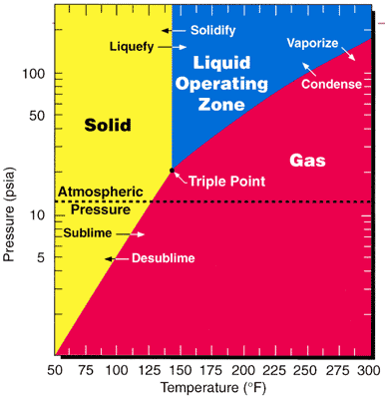
Why UF₆ ?
Advantages
Fluorine has a low atomic weight
Fluorine has only a single stable isotope
Only compound of uranium + fluorine that has a large vapor pressure at room temperature
Disadvantages
UF₆ is highly reactive with moisture
Corrosive attacks on metals and lubricating oils
Interaction with barrier materials distorts pore size and shape
Suitable barrier materials
Nickel or nickel-coated steels
Aluminum
Teflon
UF₆ determines operating pressures and temperatures
Phase diagram for UF₆
Notes:
Describe for me what UF6 is like at room temperature.
At room temp, UF6 is a colorless, volatile solid with a density of about 5 g/cc.
It sublimes (goes from solid to gas) at room temperature.
What do we do to form UF6 from a Uranium compound?
All U compounds will form UF6 when heated in the presence of fluorine to sufficiently high temperatures.
The reaction commonly used is to take UF4 plus F2 which proceeds through an intermediate UF5 step.
As you see in the phase diagram to the right, UF6 changes its phase depending on the temperature and pressure. UF6 has a boiling point of 56.5 degrees Celsius.
What is the triple point?
The triple point (where it can exist in all three forms) is about 64.1 degrees Celsius at about 20 psi (1133 torr).
As a gas, the UF6 is a perfect octahedron with bond lengths of about 2 angstroms.
In the vapor phase, UF6 molecules are unassociated and has a perfect gas behavior. Its viscosity and diffusivity properties make it favorable for gas-phase isotope separation techniques.
Why is UF6 so difficult to work with?
UF6’s reactivity is what makes it so difficult to work with. It reacts vigorously with water (UF6 + 2H20 → U02F2 + 4HF).
It is not very reactive with dry air, however.
What materials do we use because they are resistant to UF6?
Ni, Cu, and Al are all resistant (don’t react significantly with UF6).
If the UF6 is not pure (i.e. it has a little HF in it) it will attack even the most resistant metals.
How do we store the tails of UF6?
Tails in the form of UF6 are stored in self-sealing steel drums. If the UF6 starts to “leak” out it reacts with water and the resulting corrosion forms a U02F2 plug that seals the container.
Quick review: what is the separation factor and how is it defined?

Slide 10
Pop Quiz
How are the desired enrichment level and the amount of natural U feed needed related?
If you choose to have fewer stripping stages (meaning you are willing to have tails with a higher amount of 235U in them), for a given product mass (P) ad a given enrichment (xp) how does this impact the amount of feed you need?
What about if you start with a higher feed enrichment? How does the amount of feed needed change depending on its enrichment?
Can someone please work out for me how many centrifuges you need to create WGU for a gun-type if you have one year to do it?
Assume you need 75 kg and that each kg requires about 200 SWU and your centrifuges provide 5 SWU per year.
Notes:
How are the desired enrichment level and the amount of natural U feed needed related?
To get a higher enrichment, you need more feed!
What you should see from this graphic is that you need more natural U feed to produce a higher 235U enriched product.
If you choose to have fewer stripping stages (meaning you are willing to have tails with a higher amount of 235U in them), for a given product mass (P) ad a given enrichment (xp) how does this impact the amount of feed you need?
If you choose to accept a larger 235U content in your tails you would need more feed.
What about if you start with a higher feed enrichment? How does the amount of feed needed change depending on its enrichment?
As we see on the next slide, it decreases the amount needed dramatically.
Can someone please work out for me how many centrifuges you need to create WGU for a gun-type if you have one year to do it?
Assume you need 75 kg and that each kg requires about 200 SWU and your centrifuges provide 5 SWU per year.

Slide 11
Process Definitions
Separative Work Unit (SWU): a quantitative measure of separation
~ 4 SWU produces 1 kg of LEU (~3 %) from ~6 kg of natural U
~ 100,000 SWU fuels a 1 GW(e) light water reactor for one year
~ 200 SW produces 1 kg of HEU (~90%) from ~ 200 kg of natural U
Separation Factor is a customary way that enrichment is characterized
Throughput [kg U/time] defined with respect to input, not output
Cut defined as product rate / feed rate
Notes:
We frequently characterize enrichment plants based on the number of SWUs.
A SWU is a function of the amount of the U processes and the enrichment on a per kg basis.
A SWU is basically a measure of how much energy is need to fractionate the isotopes.
You should note that the amount of U235 you are willing to leave in the tails impacts how many SWU are required to enrich to a certain level. For example, for 1 kg of 3% U235 you only need 3.8 SWU if you have tails at 0.25% but need 5.0 SWU if the tails are reduced to 0.15 %. Basically, if you provide more feedstock and are willing to accept larger 235U content in the tails, you can reduce the number of SWUs you need for enrichment.

Slide 12
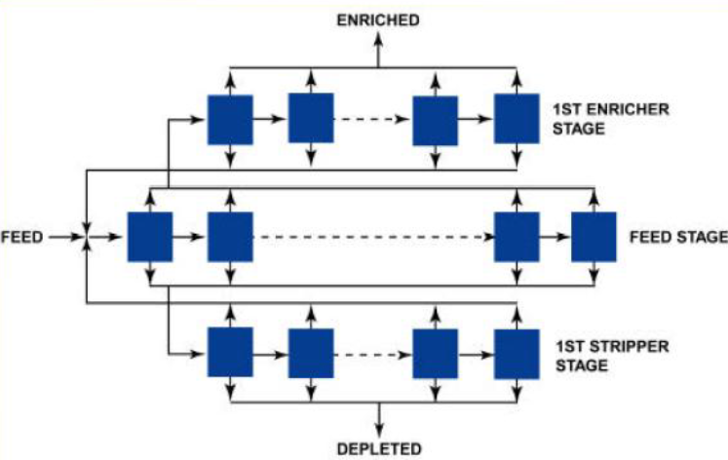
Generic Uranium Enrichment Cascade
Notes:
This is an example of a generic enrichment cascade.
While this graphic shows the tails from the enrichment stage recycling back to the feed stage, where the tails from one stage goes depends on the cascade configuration and the enrichments of each stage.
The key is to match the depleted content from one stage to the feed content for the stage it is recycled to.
In practice, it is not viable to operate an “ideal” cascade where the enrichments match perfectly so what is done is to match the flow and power requirements. This results in the relative amounts of products and tails from each being the same but it also leads to mixing of streams that have slightly different isotopic composition.
The mixing of streams leads to the ability for forensic analysis of the 234U enrichment. In an ideal cascade, 234U is enriched (relative to 235U, that doesn’t mean you have more 234U than 235U just that the factor by which it is enriched is greater). This allows you to garner information about how the cascade is operating.
For more information, check out “Nuclear Forensic Analysis” (2nd Ed) by Moody, Grant, and Hutcheon pp 96-102.

Slide 13
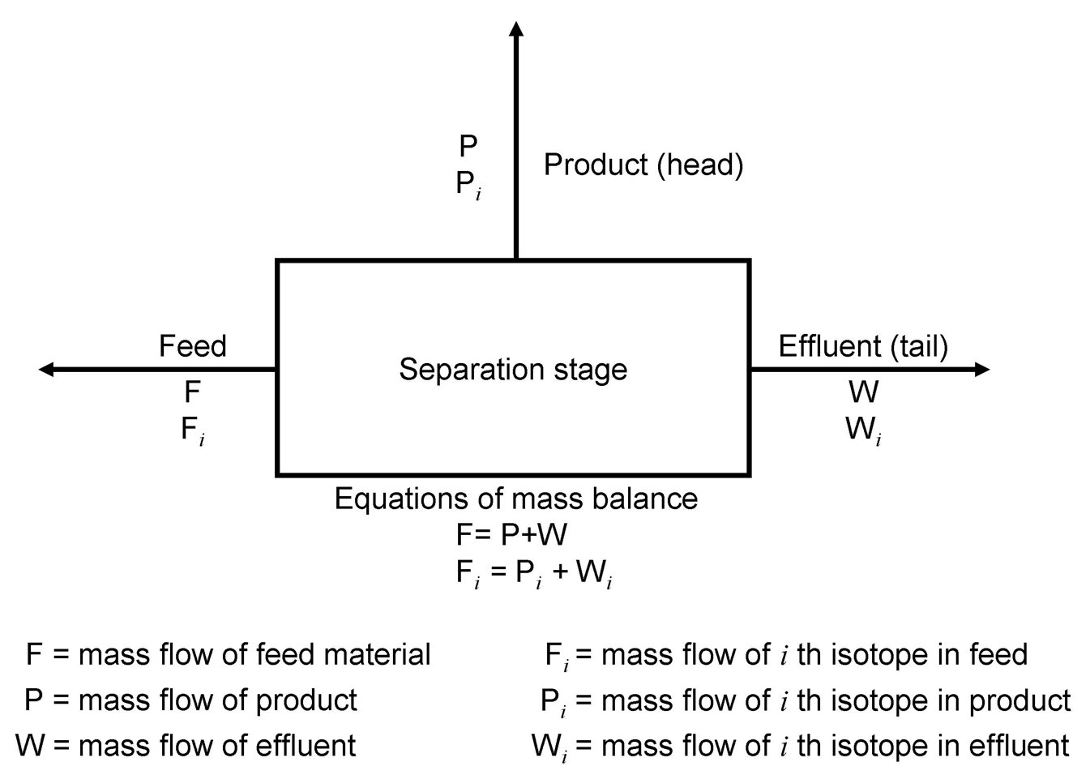
The Isotope Enrichment Stage (1 of 3)
Equations of mass balance
1
2
Let x_{f} , x_{p} , and x_{w} be the weight fractions (enrichment of isotope i) of the feed, product and tails.
Then can be re-written as:
2
3
Using to eliminate W from
gives the feed-to-product ratio:
1
3
Adapted from Kokoski, Technology and the Proliferation of Nuclear Weapons
Mass flow rates in kg/hr; Subscript i refers to isotope, e.g. ²³⁵U
4
A stage may be a single unit or many units in parallel
Most processes involve small amounts of stage enrichment
Many stages in series are often necessary (cascade)
Similarly, the waste-to-product ratio:
5
Equations of mass balance apply to a stage and a cascade
Notes:
This slide should be relatively easy—its just a matter of mass balance.
What does equation (1) describe? Balance the flow rates
What does equation (2) describe? Balance of the mass flow of the isotopes
What does equation (3) describe? Balance of the enriched isotope
What does equation (4) describe? The ratio of feed to product
What does equation (5) describe? The ratio of waste to product.

Slide 14
The Isotope Enrichment Stage (3 of 3)
Single stage separation factor
The effect of a separative element on the relative isotopic abundances of the product and waste (R_{p} and R_{w}) is given by the single stage separation factor
6
When separating two isotopes, as in uranium, the relative isotopic abundance is determined from weight fraction x as
7
The single stage separation factor
is therefore calculated as
Adapted from Kokoski, Technology and the Proliferation of Nuclear Weapons
Subscript i refers to isotope, e.g. ²³⁵U; Mass flow rates in kg/hr
8
Slightly larger than 1.000
Notes:
What does equation (6) describe? The single stage separation factor as the ratio of the relative isotopic abundances of the product to the waste streams
What does equation (7) describe? How to determine R, the isotopic ratio, given the weight fraction.
What does equation (8) describe? The single stage separation factor!

Slide 15
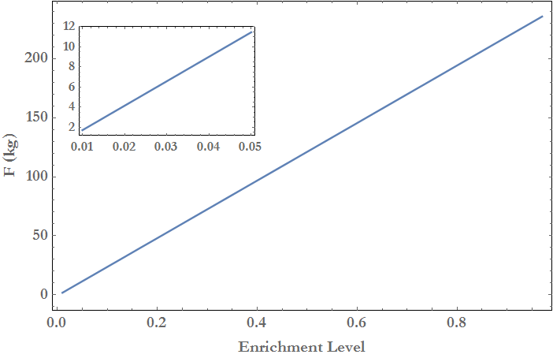
The Isotope Enrichment Stage (2 of 3)
Mass balance:
Assume natural uranium
and waste tail of 0.3%
Mass of natural uranium feed to produce one kilogram of product to the specified level of enrichment in ²³⁵U. Figure inset shows low enrichment levels from 1 -5%.
Notes:
How are the desired enrichment level and the amount of natural U feed needed related?
To get a higher enrichment, you need more feed!
What you should see from this graphic is that you need more natural U feed to produce a higher 235U enriched product.
If you choose to have fewer stripping stages (meaning you are willing to have tails with a higher amount of 235U in them), for a given product mass (P) ad a given enrichment (xp) how does this impact the amount of feed you need?
If you choose to accept a larger 235U content in your tails you would need more feed.
What about if you start with a higher feed enrichment? How does the amount of feed needed change depending on its enrichment?
As we see on the next slide, it decreases the amount needed dramatically.

Slide 16
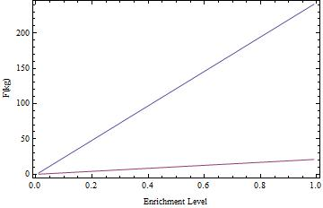
The Isotope Enrichment Stage (2 of 3)
Mass balance:
Assume natural uranium
and waste tail of 0.3%
Mass of natural uranium feed (upper line) and 5% ²³⁵U (lower line) to produce one kilogram of product to the specified level of enrichment in ²³⁵U.
Notes:
This graphic shows feed requirements for natural uranium and 5% 235U with both accepting the same requirement for tails.

Slide 17
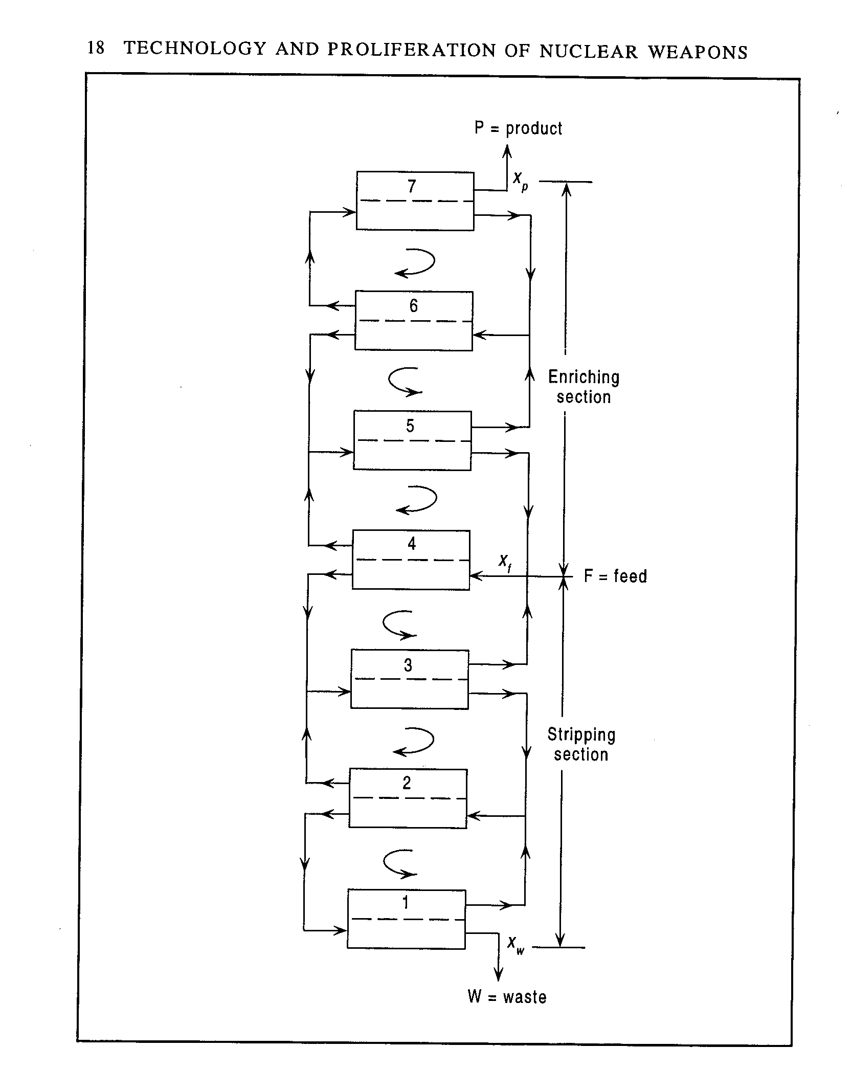
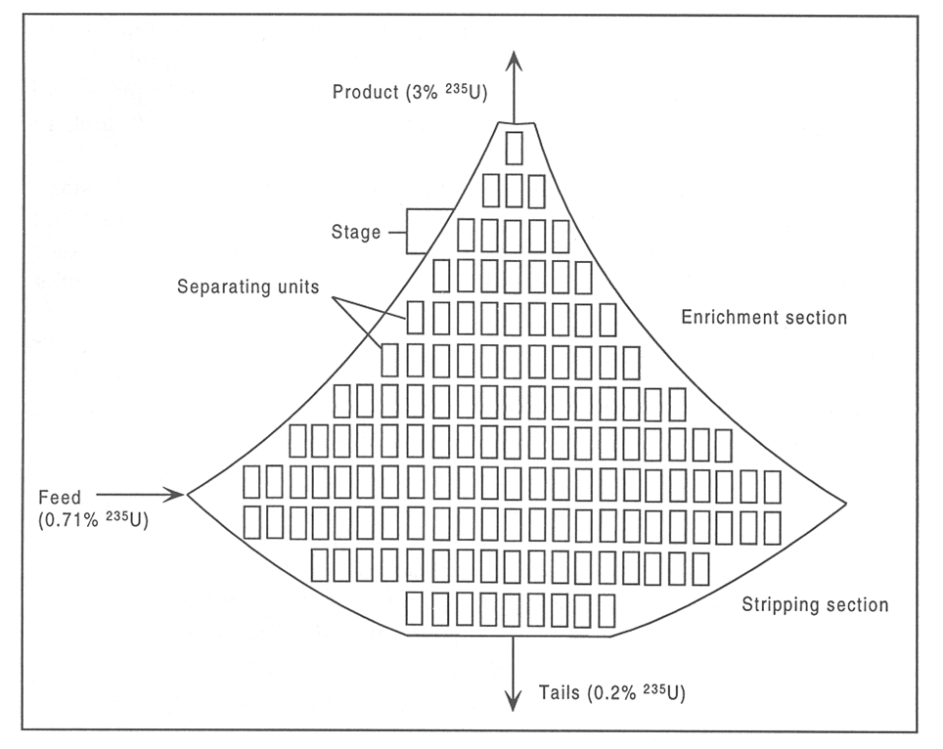
Isotope Enrichment Cascades (1 of 2)
Countercurrent cascade
Tapered cascade
Kokoski, Technology and the Proliferation of Nuclear Weapons
Ideal cascade properties
The waste from the stage above equals the product from the stage below
Power consumption (separative work) is minimized
Interstage flow is minimized
Notes:
Can you explain the cascade shown?
Each “box” represents a piece or unit of separation equipment, i.e. a centrifuge or a gaseous diffusion device
Each row represents a “stage.” All the devices in a stage have the same feedstock, product, and waste isotopics.
For any given row (stage) seen above, the individual units operate on UF6 of the same enrichment.
Ideally, the tails from a given stage are reintroduced where the enrichment level is equal.
An assembly of stages is a cascade.
Can you describe what happens in this cascade? (which happens to be shown for 3% enrichment)
The initial feed (usually 0.7% U235) in its working form, UF6, is introduced to the cascade. This “stage” will always have the most mass of any given stage.
The units in a stage operate in parallel to enrich the UF6 in 235U
The enriched gas (product) is passed to the next higher stage where it is further enriched and passed upward.
The number of stages in the enrichment section determines the final enrichment.
Enrichment to weapons grade would require many more stages in the enrichment section or would require the re-cycling of the 3% enriched as feedstock into another cascade where it could be further enriched.
The depleted UF6, called waste or tails, is passed downward to the stage below where it is re-enriched.
The product from each stage in the stripping section is then passed upwards and the tails are passed downward for further stripping.
What explains the shape?
The quantity of 238U in the cascade is much greater than the quantity of 235U so each successive step in the cascade must be smaller (larger) than the previous step for the enrichment (stripper) stages.
Note that each stage (and each unit) consumes power to drive the units in that stage so the design of a cascade is a trade-off between the cost of that power and the enrichment of the U235 that appears in the product of the cascade as well as the depletion of the tails.
The final tails of the enrichment plants are the source of the DU that you may encounter in your military career.

Slide 18
Isotope Enrichment Cascades (2 of 2)
Ideal cascade
Global ideal cascade parameters
The number of stages in an ideal cascade can be calculated as:
9
The physical effort needed to reach a certain enrichment, x_{p}, is given by a quantity known as the Separative Work Unit (SWU):
10
where V is separation potential, given as:
11
Kokoski, Technology and the
Proliferation of Nuclear Weapons
The total interstage flow of material provides the amount of feed material that must be pumped through a cascade to yield a separation factor for a required amount of separative work S.
12
Notes:
What does equation (9) describe? The number of stages in an ideal cascade for a given enrichment with a known separation factor.
Can someone please work out for me how many centrifuges you need to create WGU for a gun-type if you have one year to do it?
Assume you need 75 kg and that each kg requires about 200 SWU and your centrifuges provide 5 SWU per year.

Slide 19
Separative Work – Back of the Envelope
The separative work required to produce 1 kg of weapon grade uranium enriched to 93% ²³⁵U is approximately 200 SWU / kg (assume x_{f} = 0.71% and x_{w} = 0.3%)
Weapon production
Gun type requires approximately 75 kg of 93% ²³⁵U
Implosion type requires 25 kg of 93% ²³⁵U
A single centrifuge unit generates up to 5 SWU per year
In one year, how many units would be required to produce a single gun type weapon? (3000 units) A single implosion type weapon? (1000 units)
Centrifuge electrical bill
1 kWh costs approximately $0.10
Each generated SWU requires about 100 kWh (previous slide)
What’s the electric bill? ($150K, $50K for gun, implosion).
Notes:
For the U-weapon:
Each kg of WGU requires about 200 SWU/kg.
Each centrifuge is worth about 5 SWU/yr
You need 75 kg of WGU therefore
(75 kg WGU) * (200SWU/kg) / (1 yr * 5 SWU/[centrifuge.yr]) = 75*200/5 = 75*40 = 3000 centrifuges
You can work out the Pu weapon on your own.
And you can also work out the associated electric bill!

Slide 20
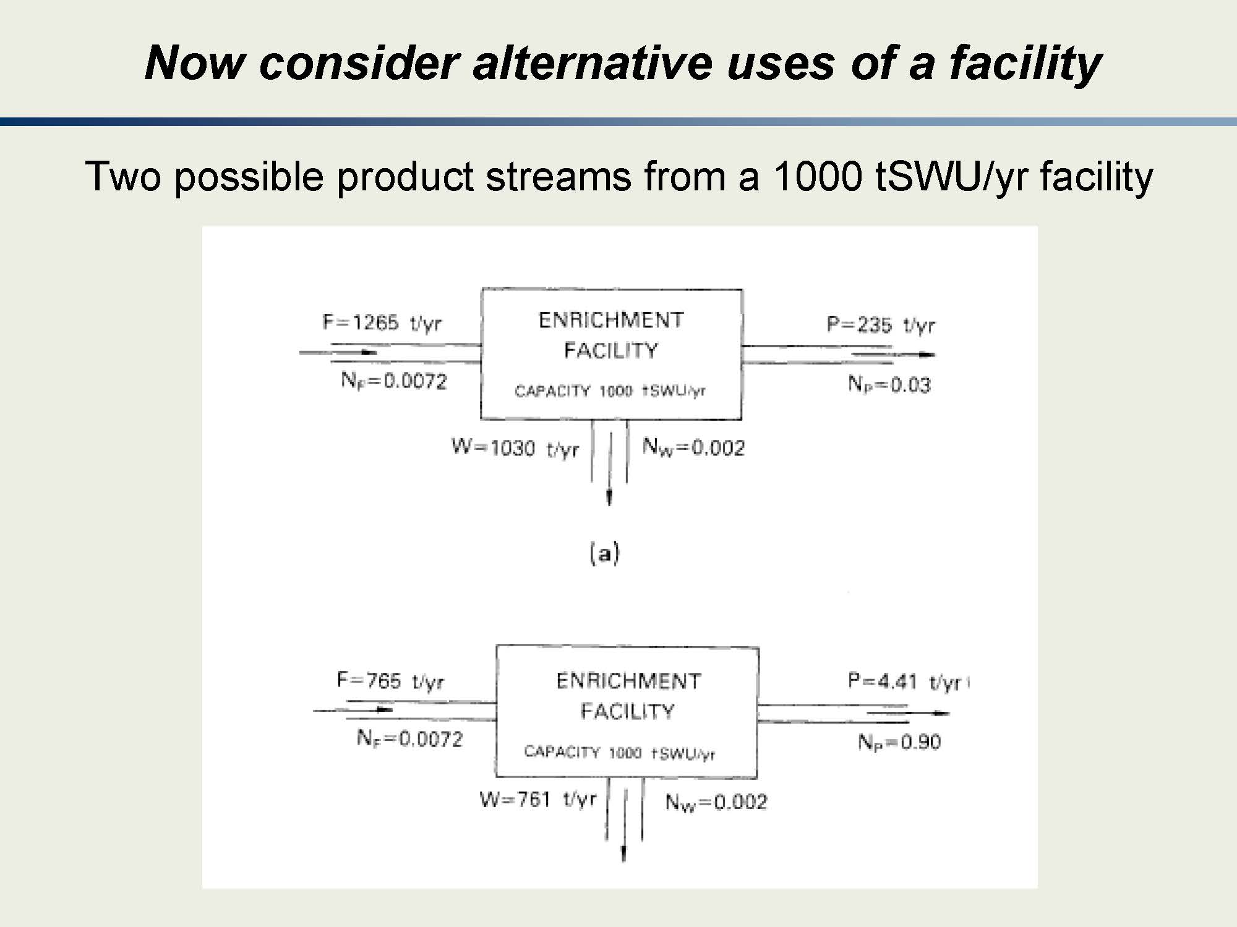
Notes:
The point of this slide is that for an enrichment facility of a given capacity, you can have vastly different results.
Of course, we should note that the CONFIGURATION of the plant will be different.

Slide 21
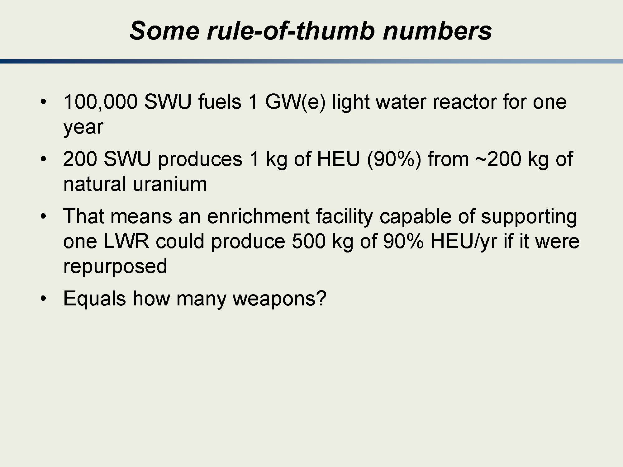
Notes:
There are just some heuristics.

Slide 22
Methods of Uranium Enrichment
Most Commonly Used:
Gaseous diffusion
Gaseous centrifuge
Well studied, limited deployment:
Electromagnetic separation
Chemical processes
Laser isotope separation
Investigated, marginal deployment:
Thermal diffusion
Aerodynamic separation
Etc?
Notes:
Marginal deployment does not mean marginal effectiveness. Although in the case of thermal diffusion that may be true.

Slide 23
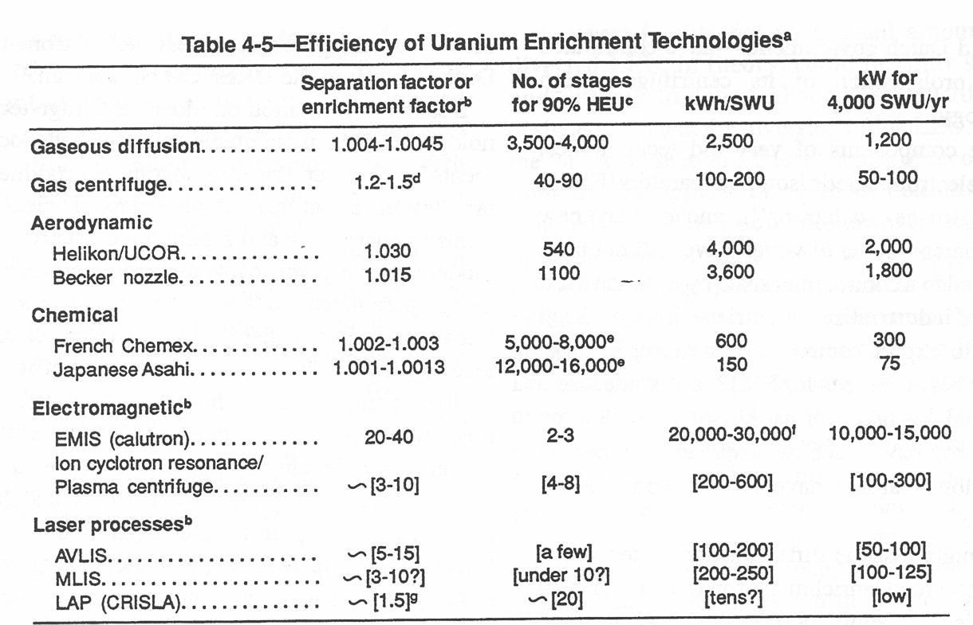
Separative Work – Apples to Apples
Notes:
We’ve just introduced you to the types of uranium enrichment and we previously talked about SWUs.
Here is a comparison of several of the techniques.
As we go through this lesson, you will gain a greater understanding of the “why” behind the differences that are noted in this simple chart.
There is a lot of important information:
Column (2): Note the relative magnitude of these numbers.
Column (3): # of stages. As you might expect, larger separation factors equate to fewer stages needed
Column (4): kWh/SWU. Massive power signatures for some methods?
Column (5): kW for 4000 SWU/yr. Here we are putting apples to apples so you can see the relative power requirements.

Slide 24
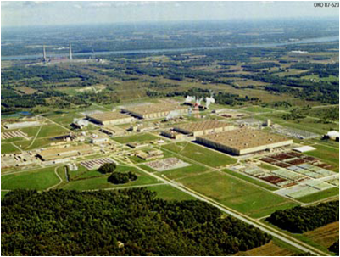
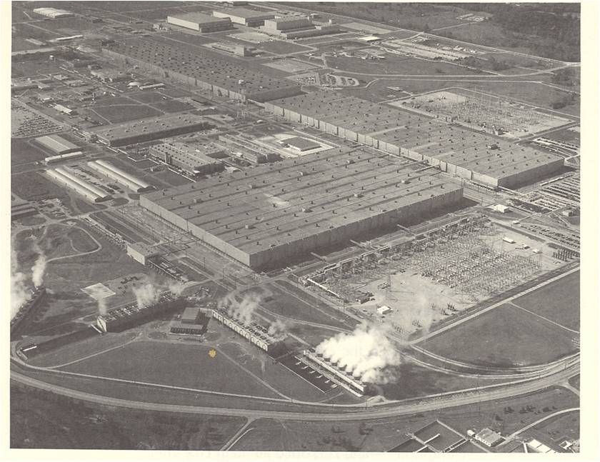
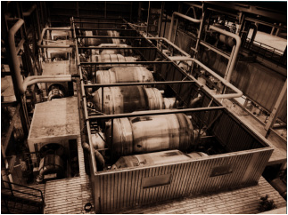
Gaseous Diffusion (1 of 5)
Provides approximately 40% of current world enrichment capacity (Laughter, 2009); being phased out by gas centrifuge
Higher separation factor for centrifuge noted in 1940s, but technology did not support centrifuge drum rotations
Uses UF₆ gas forced through a porous barrier
Historic US plants
Oak Ridge, TN (1945 – 1987)
Paducah, KY (1952 – May 31, 2013)
Portsmouth, OH (1954-2001)
Paducah Gaseous Diffusion Plant
Gaseous Diffusion Cell (4 ft x 8 ft)
Portsmouth Gaseous Diffusion Plant
Notes:
Gaseous diffusion
Approximately 40% of worldwide separation technology (accounted for 95% in 1978)
Being replaced by gas centrifuge
Need ~ 4000 stages and several months for HEU enrichment (since a very small separation factor)
Commonly used process for overt uranium enrichment
Staggering energy requirements make it an unlikely option for covert enrichment

Slide 25
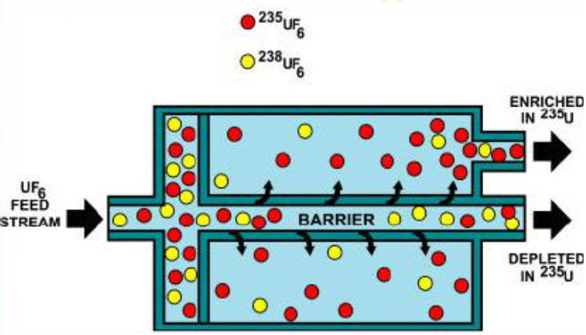
Gaseous Diffusion (2 of 5)
Barrier is a porous material
Film type—pores are created in an initially nonporous membrane (brittle)
Aggregate barrier—pores comprise strings of voids between particles that are pressed and sintered to form the barrier.
Thermal equilibrium so lighter U235F6 molecules pass (“diffuse”) through barrier slightly faster than heavier U238F6 molecules
Notes:
The main concept is that thermal equilibrium within the container means the molecules will all have the same kinetic energy.
Since the 238UF6 has a larger mass, it will have a smaller velocity than 235UF6 at the same kinetic energy.
Since the 235UF6 has a larger velocity, it will try to penetrate the barrier more often than the 238UF6 so a higher relative fraction of the 235UF6 will pass through the barrier.
Thus, the product will be “enriched” in 235UF6 content.
The ratio of the masses is 352/349 (235UF6 / 238UF6) and, with the relation for kinetic energy (mv^2/2) we should achieve a separation factor of (352 / 349)^(1/2) =1.0043.
This method is possible because the F has a single stable isotope.
As previously discussed, UF6 is reactive so the barrier material must be corrosion resistant.
Additionally, the holes in the barrier must have a diameter smaller than the MFP of the molecule to be separated. (If the molecules were to make collisions within the barrier, equipartition of energy would make the separation method ineffective.)
Additionally, the barrier must be thin enough so that it has sufficient permeability at low energies.
Heat exchanger is needed to maintain thermal equilibrium
Seals are created from special materials.

Slide 26
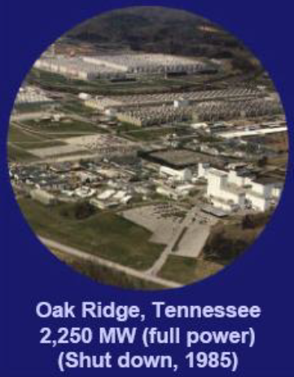
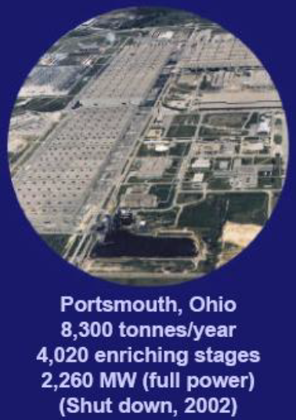
Gaseous Diffusion (3 of 5)
Oak Ridge, Tennessee
Portsmouth, Ohio
Notes:
K25 plant at Oak Ridge was 6 stories high and covered 43 acres

Slide 27
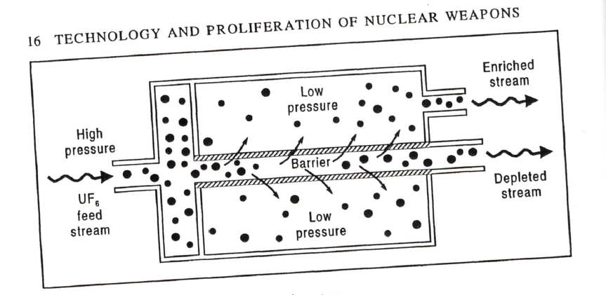
Gaseous Diffusion (4 of 5)
Diffusion Physics
In a gas consisting of several types of
molecules, each molecule will have the same average kinetic energy.
1
The molecules containing ²³⁵U will move faster than those containing ²³⁸U by the ratio of their masses.
Reproduced from Kokoski, Technology and the Proliferation
of Nuclear Weapons
Diffusion Process
Feed gas flows past diffusion barrier
Mean free path of the UF₆ molecules is larger than the pore size of diffusion material (5 – 30 nm)
Feed gas on the lower pressure side is slightly richer in ²³⁵U than ²³⁸U
Barriers must be thin, withstand large pressure differences, and not be chemically reactive with the feed gas
2
where m₂₃₈ and m₂₃₅ are the masses of ²³⁸UF₆ and ²³⁵UF₆. The increased frequency of ²³⁵UF₆ passage defines the separation factor
3
Notes:
Understanding the physics is EXTREMELY important. If you know the physics, you understand gaseous diffusion.
What does equation (1) show and where does it come from?
Molecules have equal kinetic energy.
How does equation (2) explain why the 235U will attempt to pass through the barrier more often than the 238U?
A higher velocity means more attempts to “tunnel” through the holes.
Do you understand how equation (3) shows that the differences in the masses explains our separation factor?
With equal energies, it’s all about the masses / velocities!
What happens if the “holes” are too big (too wide or too thick)?
Then the gas just goes to equilibrium. Too wide and everything passes through. Too thick (greater than the mfp) and we’ll have interactions and the particles won’t separate and diffuse through.
Feed gas enters at about 0.3-0.5 atm.
Flow is adjusted so about half of the feed diffuses through the barrier walls (creating enriched product)
Lower-pressure streams are cooled with heat exchangers and recompressed. (Preheating is required since UF6 heats substantially when compressed)
Neutralizing the compression heat is the largest source of energy consumption at a gaseous diffusion plant.

Slide 28
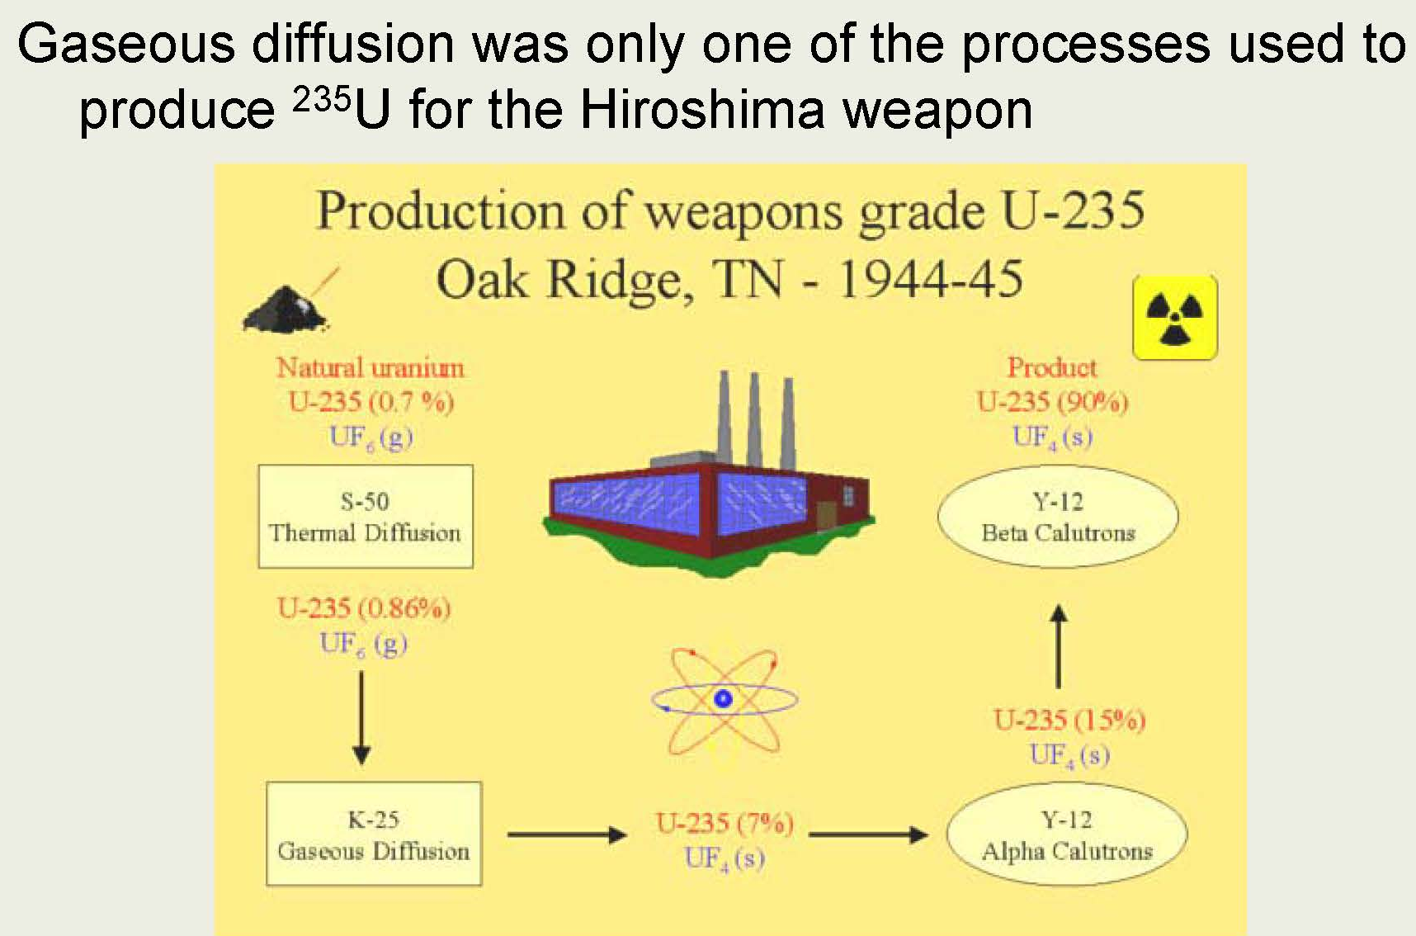
Gaseous Diffusion (5 of 5)
Notes:
At one point, the US had to use reprocessed uranium.
The reprocessed U also contained Np, Pu, and Tc, which all have volatile fluorides.
These volatile fluorides are all very reactive and reacted with the (then) Ni diffusion barrier.
In later enrichment efforts (with UF6 that had never seen a reactor) 237Np isotopes were found in the product! (It must have come from material that was already in the gaseous diffusion plant!)

Slide 29
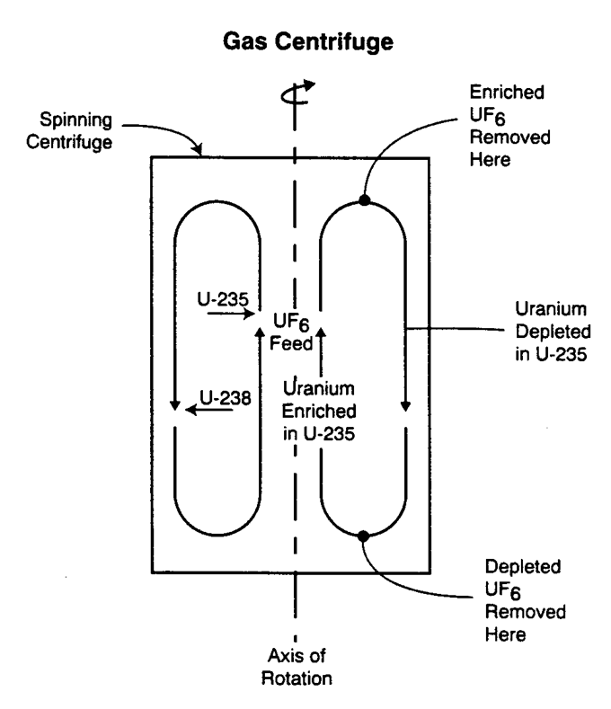
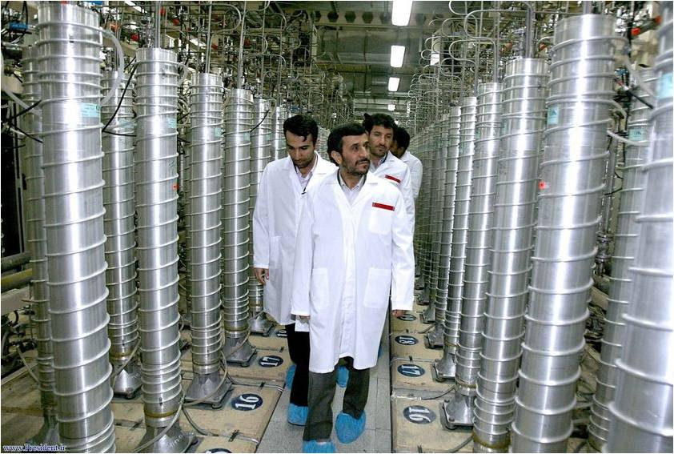
Gaseous Centrifuge (1 of 9)
Centrifugal acceleration created in a cylinder rotating at high speeds
Rotation increases the concentration of ²³⁸UF₆ molecules near the cylinder walls; molecules forced downward by thermal gradients
Higher separation factor and lower power consumption than most methods
US Enrichment Corporation plans for gas centrifuge to replace gaseous diffusion when and if U.S. production resumes (Portsmouth)
Modern centrifuge materials (Kokoski, 44)
Material | Density (kg/m3) | Tensile Strength (MPa) | Max velocity (m/s)
Aluminum alloys | 2,800 | 448 | 400
High-tensile steel | 7,800 | 1381 | 421
Titanium | 4,600 | 897 | 442
Maraging steel | 7,800 | 1932 | 498
Glass fiber | 1,800 | 490 | 522
Carbon fiber/resin | 1,600 | 829 | 720
Notes:
The basic concept of the gas centrifuge is that the 238UF6 gas will move preferentially to the outside of the centrifuge (because of its larger mass). This will allow you to take enriched 235UF6 from closer to the inside of the centrifuge.
Separative capacity increases with rotor speed and length
Gaseous centrifuge has a higher separation factor and lower power consumption than most methods
Need ~ 100 stages and less than 1 day for HEU enrichment (once at equilibrium)
Rotor spins at very high rates (~ 1000 Hz)
Note that the “best” centrifuge material is one that is low density (less energy needed to spin it) and has great tensile strength (so you can operate it at a very high pressure).
Currently the most widely deployed enrichment method

Slide 30
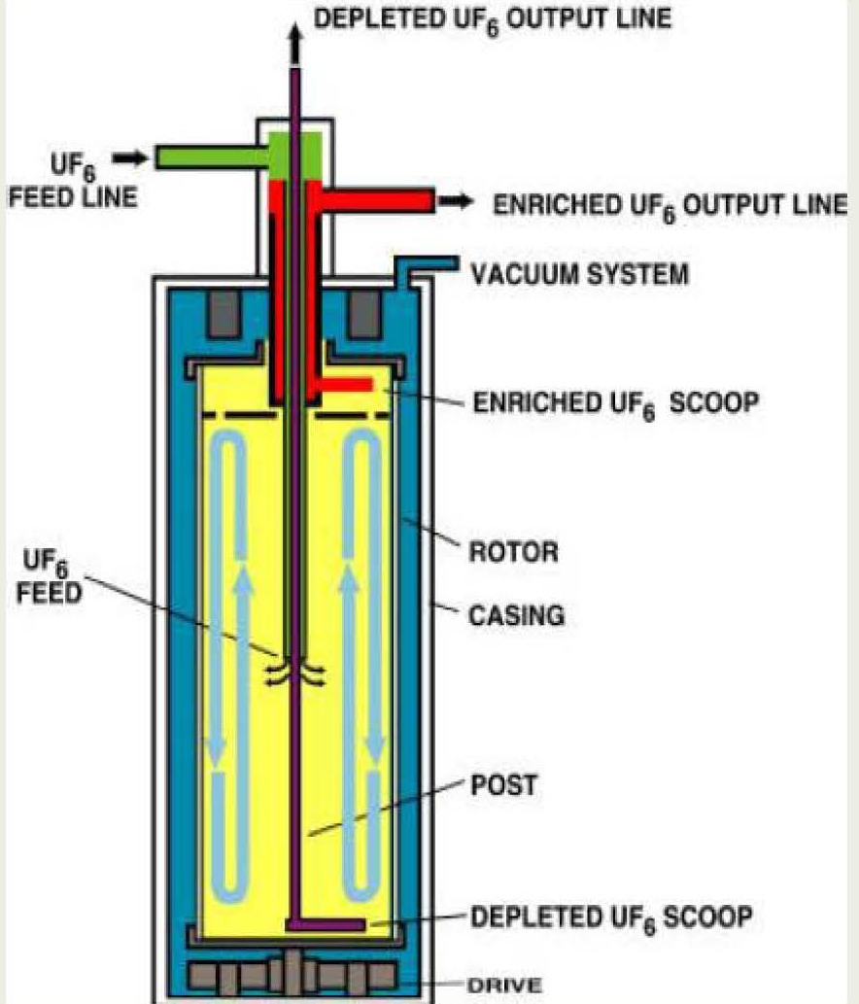
Gaseous Centrifuge (2 of 9)
Separation factor for a 10cm centrifuge at 1000 rpm at 35 degrees Celsius:
So why hasn’t it replaced diffusion?
Sunk costs / capital investment.
Challenges with operating high-speed centrifuges, e.g.
acceleration at 4x10⁵ gravity!
seals
rotating and accelerating
Notes:
The calculated ideal separation factor is the ratio of the isotopic abundances at the center of the centrifuge to that near the wall
This means you have to extract product from the axis of the centrifuge and the waste from the wall.
But the gas pressure at the wall is millions of times greater than at the center. Attempting to get product from the near-vacuum at the center would be fruitless.
To resolve this, the centrifuge was designed to rotate around a (stationary) central post that makes a seal with the body of the centrifuge rotor at the top.
As the centrifuge spins, the bulk of the UF6 accumulates along the cylindrical wall.
A bottom scoop removes tails, the feedstock is supplied halfway up the body near the axis.
The removal of tails and feedstock supply establish a vertical countercurrent plow that causes exchange between the layers of gas with different isotopic compositions.
Most of the enrichment takes place near the centrifuge wall.
Countercurrent flow allows low-pressure product diffusion to the top scoop where it is removed.
The separative power is sensitive to the countercurrent flow pattern.
The vacuum vessel surrounding the centrifuge minimizes drag and eliminates environmental variables that lead to instability (vibrations) during centrifuge motion.
If you think about classical physics (the harmonics) there are obviously some rotational frequencies that you want to accelerate through very quickly so you don’t destroy your centrifuge.
Resonant frequencies at high rotational speeds can lead to mechanical stresses that will destroy the centrifuge.
Separative capacity increases with rotor speed and length
Longer and faster means better separation but you have to engineer it…
Modeling it is very complex so much of the “design” is done through trial and error.

Slide 31
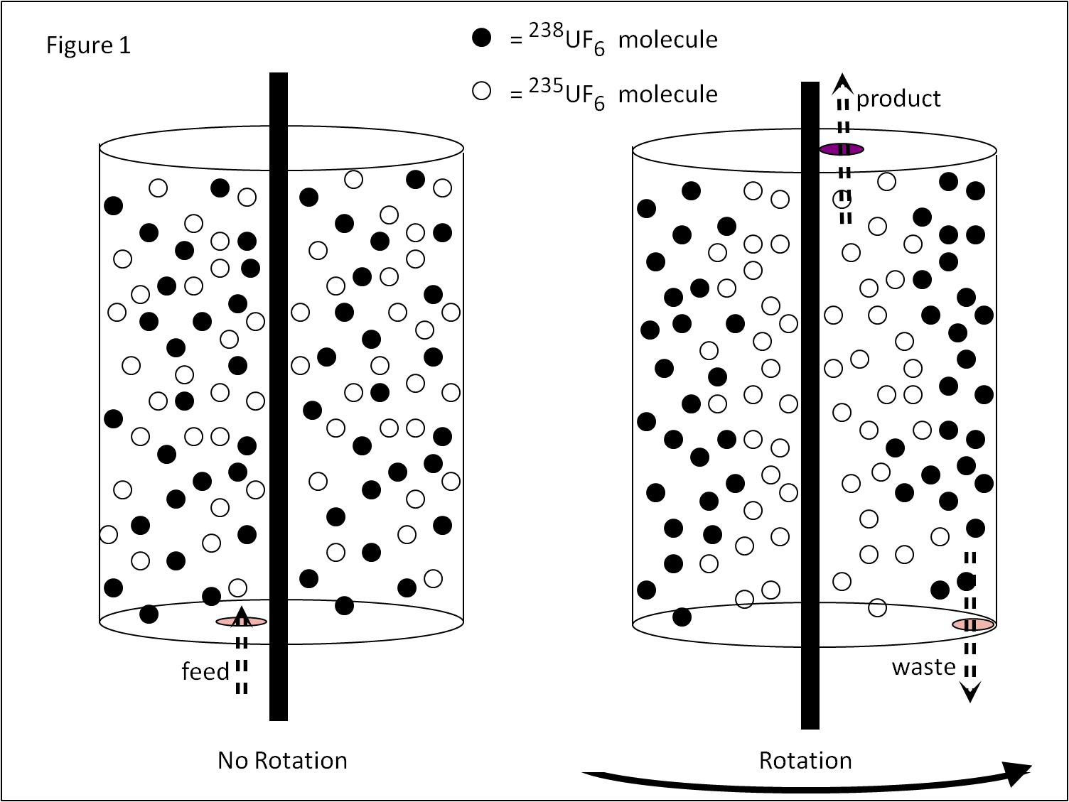
Gaseous Centrifuge (3 of 9)
Assuming an ideal gas, solve for and substitute into :
5
6
And solving the above differential equation gives:
7
The pressure gradient at a given point inside the centrifuge gives the force per unit volume of gas:
The separation factor is the ratio of partial pressures of the gases:
4
8
Substituting expressions for the centrifugal force and expressing volume as a function of mass and density yields, after substitution into :
where m₂₃₈ and m₂₃₅ are the masses of ²³⁸UF₆ and ²³⁵UF₆ and
4
5
Full derivation (PDF) in course folder
Notes:
Here is the physics / mathematics behind it.
Again, it is all about the physics.
What does equation (4) show?
The change in pressure depends on the force and the volume.
What does equation (5) come from?
We know, because Newton told us, that F = ma = v²/r.
We know that mass / volume = density.
We know that omega (rad/s) = v/r
Put it all together and you get the right side of (5)
What does equation (6) describe?
We substitute 5 into 4 and do some algebra to get our diff equation.
What does equation (7) describe?
This is the solution to the diff Eqn. It sure looks like the pressure depends on mass and radial position.
What does equation (8) show?
You can go through and do the work for this (done in some hidden slides or you can ask me for an alternative solution.
In the end, you see that the differences in the kinetic energy of the U238 and U235 appears in the exponential term.

Slide 32
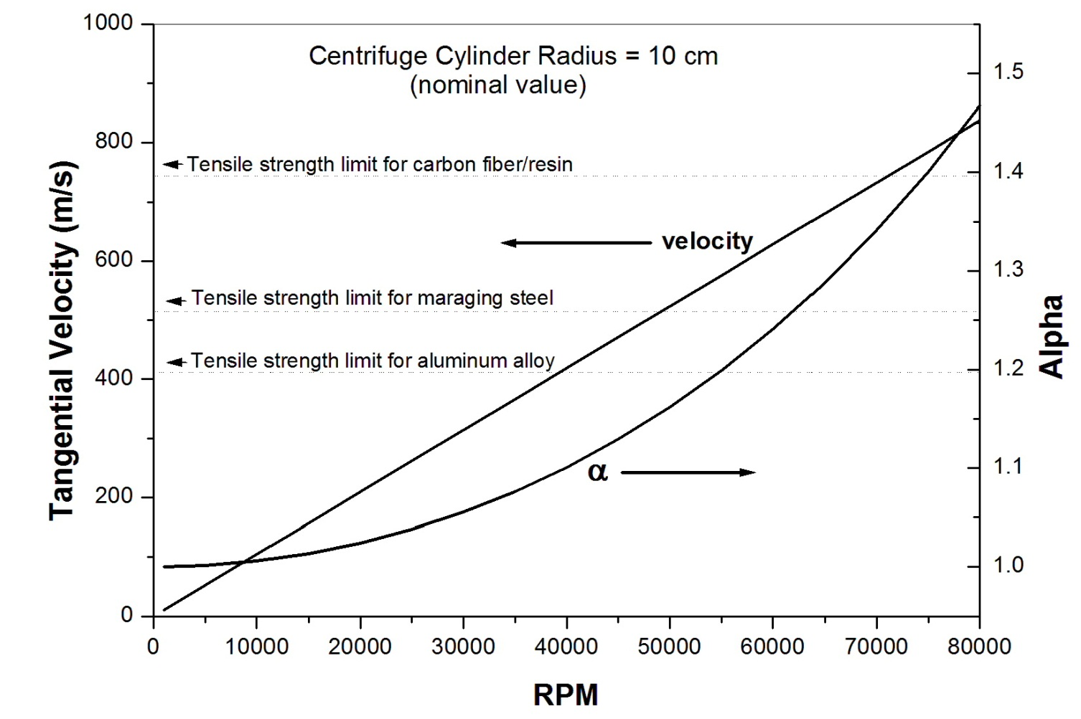
Gaseous Centrifuge (4 of 9)
Separation Factor vs. Rotation Rate
In the early years (1940s and 1950s) the materials for centrifuge construction were limited to aluminum and steel and rotational speeds were limited to about 30,000 RPM.
Notes:
Key point here is that as you rotate more quickly, you increase your separation factor.
Of course, we know that there are resonances in the material. If you rotate something at one of its natural harmonics, it will start to deform.
Thus, one of the keys is you need to be able to accelerate quickly through any harmonics so you do not destroy your centrifuges.

Slide 33
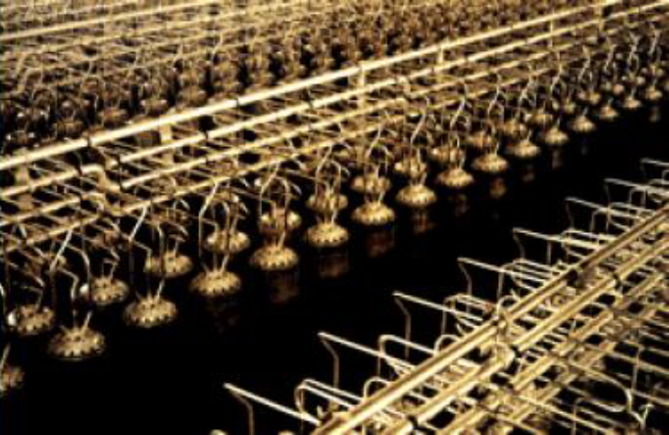
Gaseous Centrifuge (5 of 9)
URENCO “A.Q. Kahn” Style Cascade—individually mounted, i.e. a single rotor in each casing
Other facilities may put several rotors within each casing
Notes:
As you might imagine, a catastrophic failure of a single centrifuge can destroy or damage many other centrifuges.
Can you imagine what happens when a centrifuge catastrophically fails? Imagine the momentum carried away by the “pieces” and what it does when it his other casings!!!! Not a good day.

Slide 34
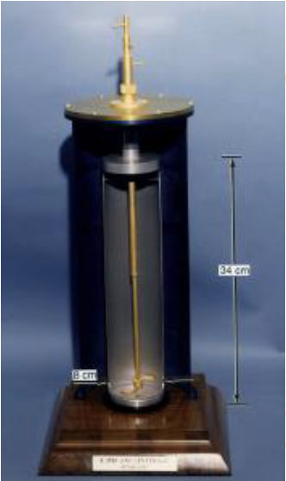
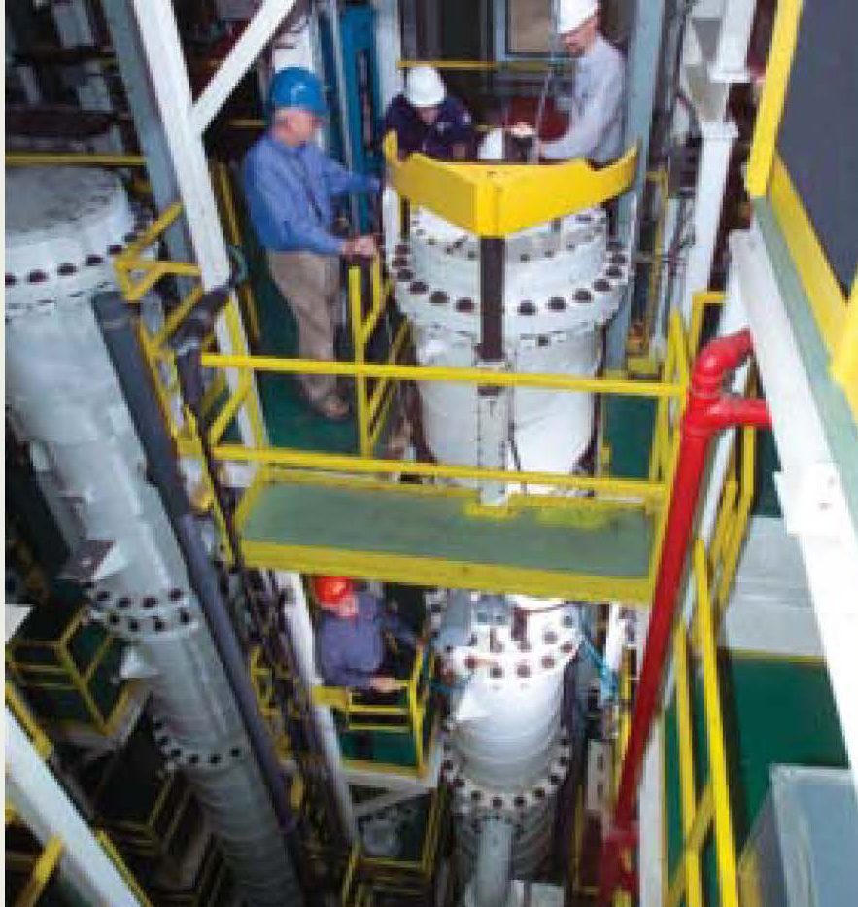
Gaseous Centrifuge (6 of 9)
U.S. Centrifuges
Notes:
Left circa 1958, right today.

Slide 35
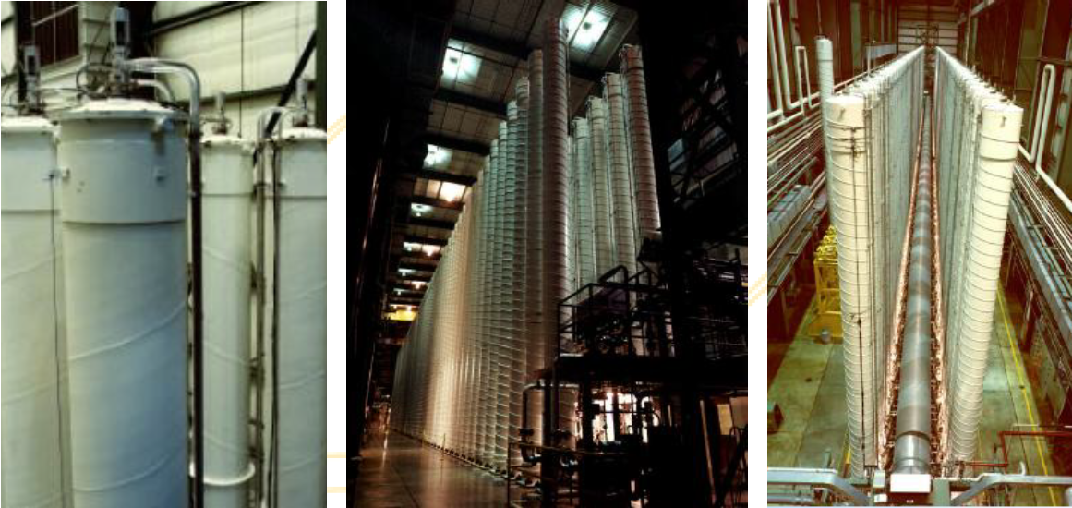
Gaseous Centrifuge (7 of 9)
U.S. Centrifuges
Notes:
Left circa 1982, middle & right are DOE Pilot Plant

Slide 36
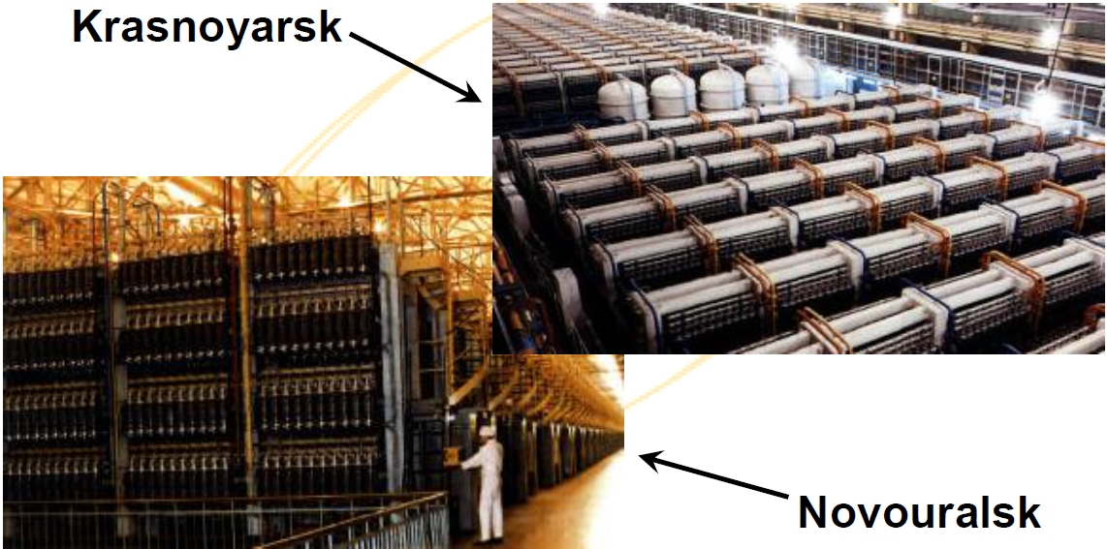
Gaseous Centrifuge (8 of 9)
Russian Centrifuges
Notes:
Some Russian centrifuges.

Slide 37
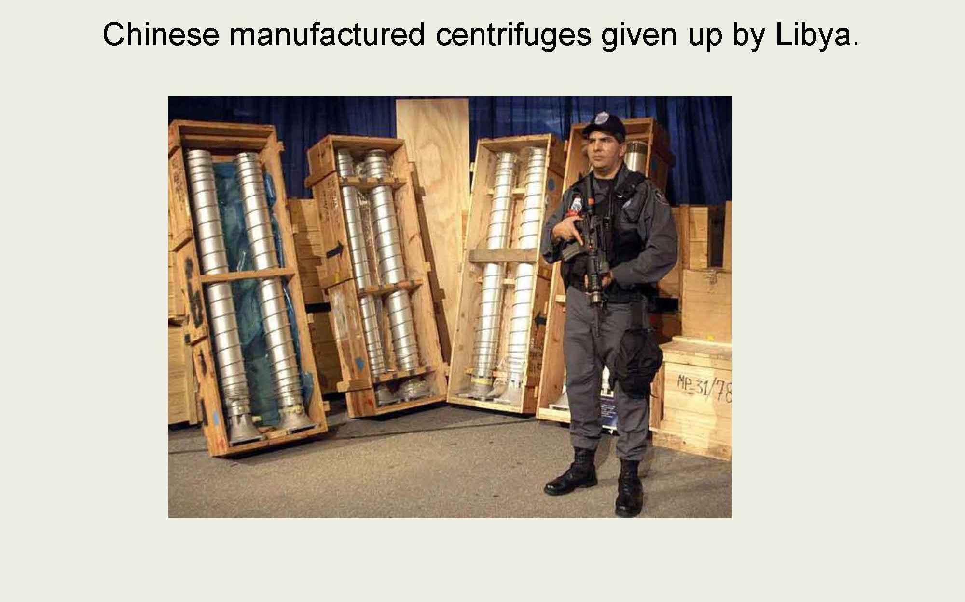
Gaseous Centrifuge (9 of 9)
Notes:
The famous picture of Chinese centrifuges given up by Libya.

Slide 38
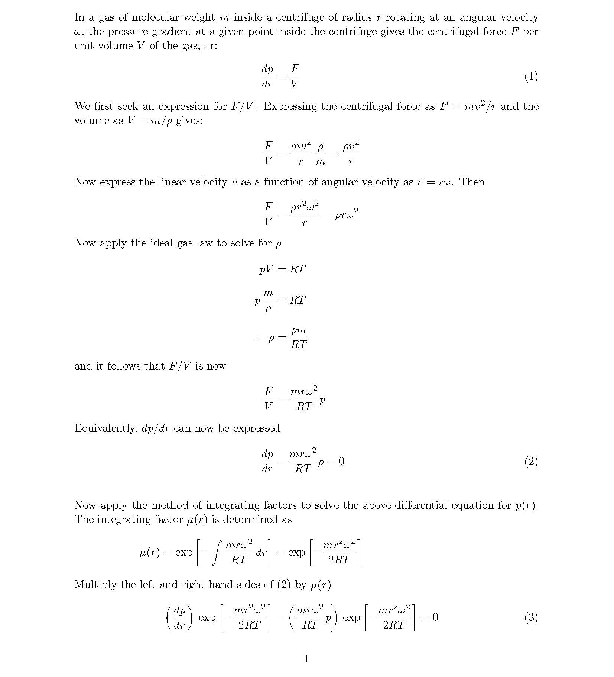

Slide 39
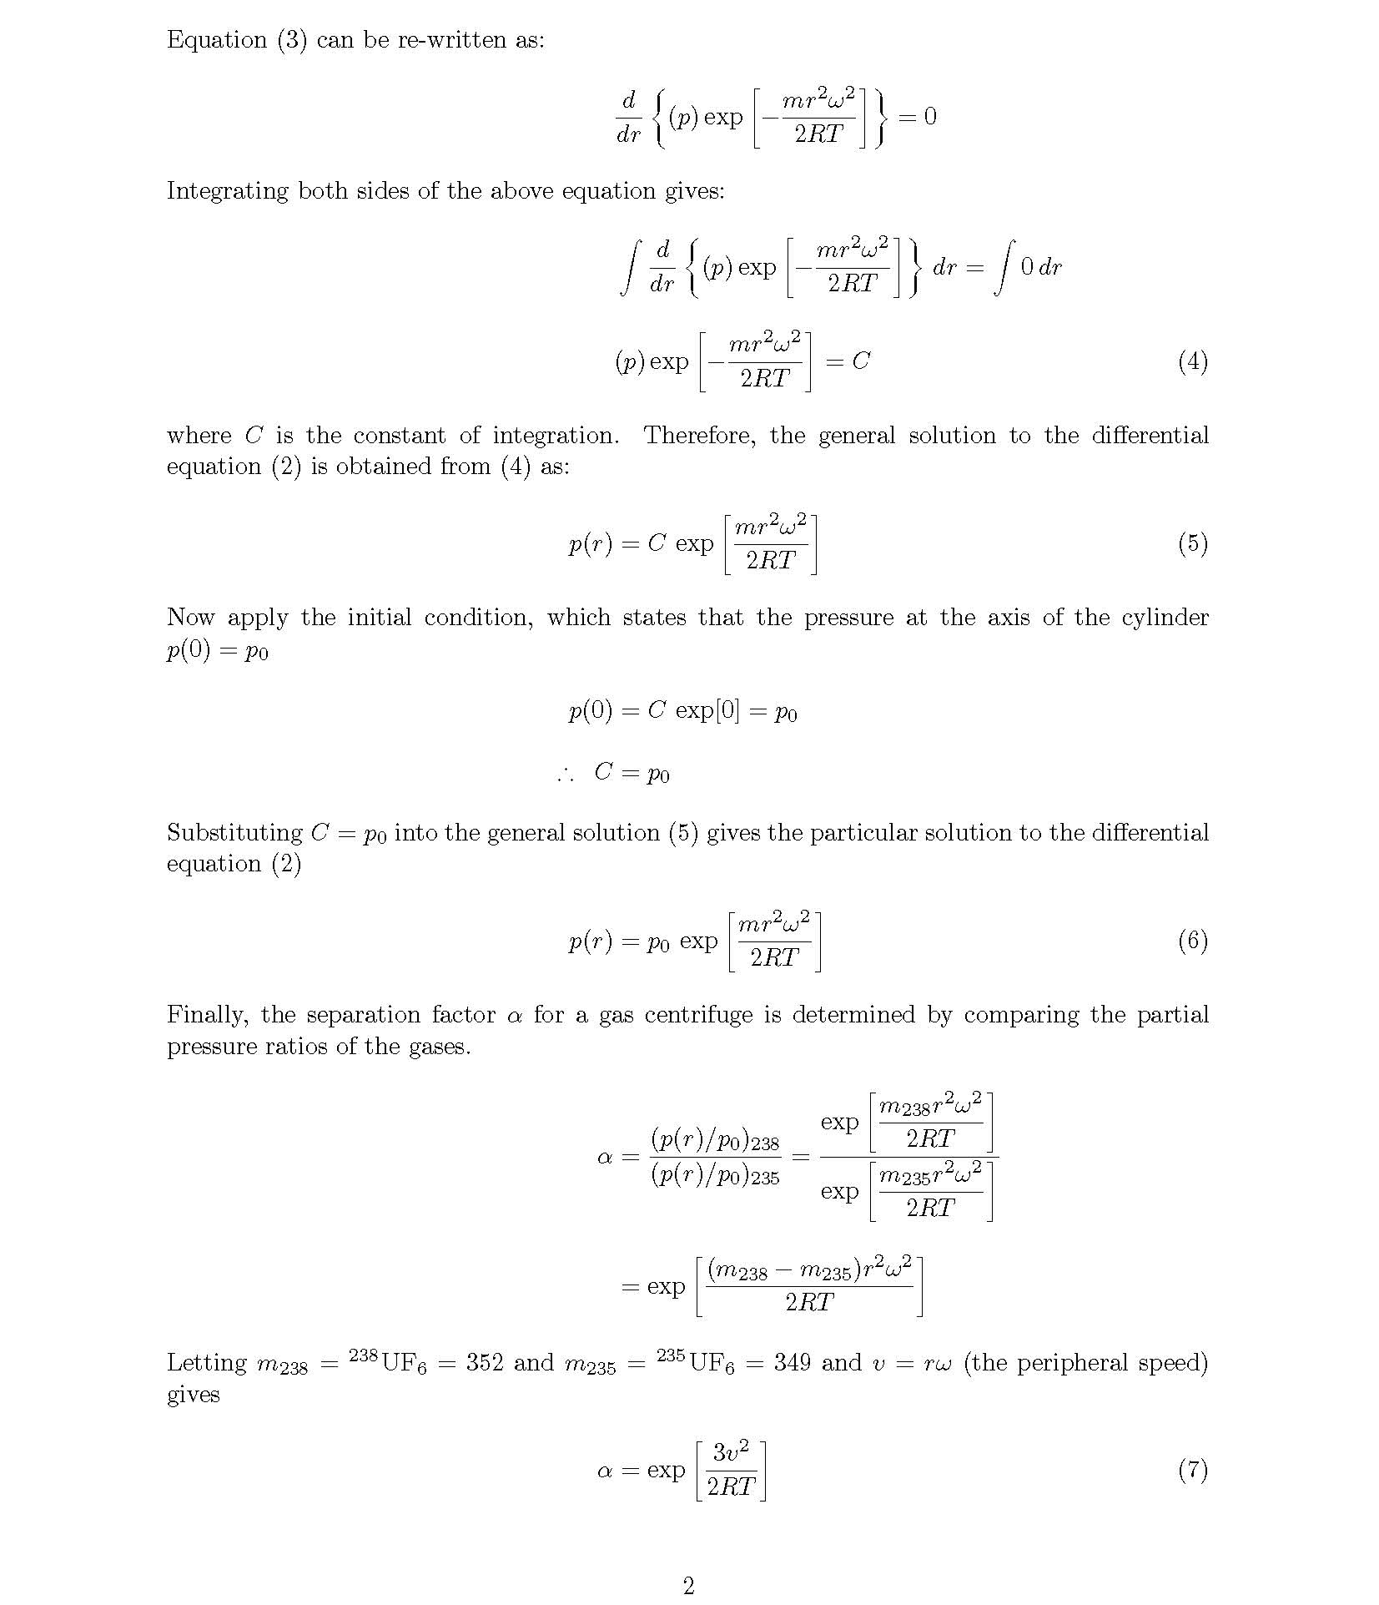

Slide 40
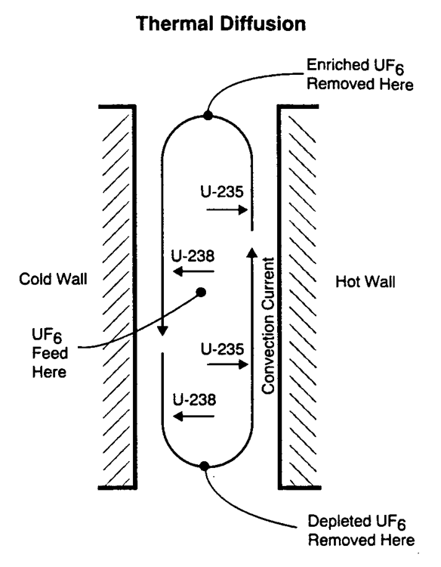
Thermal Diffusion
UF₆ in liquid (or gas) state subjected to large temperature differences
²³⁵UF₆ tends to concentrate at the hot wall and rise
Separation factor less than all other methods, α = 1.0003
Method can only be used to achieve low enrichments
Used in 1944 to produce slightly enriched feed from 0.71 % to 0.9 %
No large scale use since then is known
Notes:
Thermal diffusion – old, inefficient technology that was used during WWII.
It was used to enrich 235U content from 0.72% to 0.86% and then used as feedstock for the calutrons that produced HEU for the Hiroshima bomb. It took about 2 months to achieve this and then yielded about 60 g/day/column.
Again, its all about the physics.
Thermal diffusion relies (like gaseous diffusion) on the differences in the speeds of the 235UF6 and 238UF6.
With a temperature gradient, the heavy component tends to concentrate at lower temperature. It doesn’t have as much energy so it doesn’t move around as much.
The apparatus consists of two concentric vertical tubes.
The inner tube made of Ni (right in the picture) has high temperature steam.
The outer tube made of Cu (left in the picture) is cooled by water.
Ni spacers are used to keep the tubes apart, by < 1 mm. Spacing determines the effectiveness of the method.
200 atm UF6 is introduced to the device. This is needed to keep the UF6 in the liquid phase near the hot wall. (Allowing it to boil would create non-laminar flow and disrupt separation.)
Lighter molecules move up the hot wall and heavier molecules move down the cold wall.
While you could theoretically design the tube for any enrichment, the physical dimensions and time requirements make very high enrichment impractical.

Slide 41
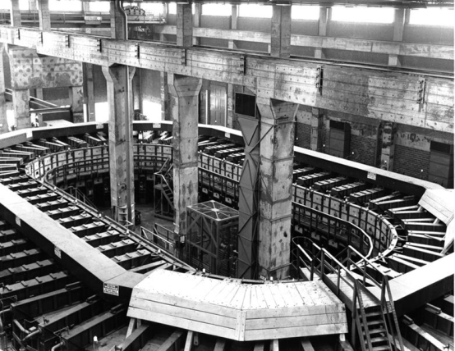
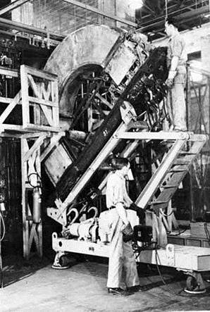
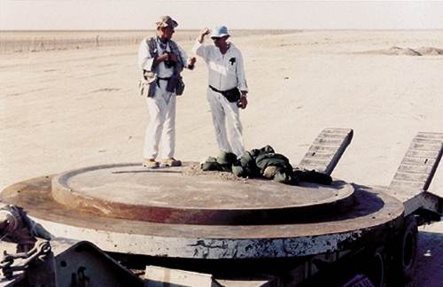
Electromagnetic Isotope Separation (EMIS) (1 of 5)
First US production process at Oak Ridge, TN (Y12 plant)
“Alpha” machines
Enriched to 15%
Radius of curvature of 4 feet
96 stages
“Beta” machines
Enriched from 15% to 90%
Radius of curvature of 2 feet
36 stages
Old technology – why study?
Iraq clandestinely duplicated the 1944 Oak Ridge design
Other proliferators may replicate
Oak Ridge “Alpha” racetrack
“Alpha” calutron tank
Iraqi EMIS equipment, 1991
Notes:
EMIS enrichment works with the concept of differential deflection in electric and magnetic fields.
Nier conducted an experiment in 1940 during which he used vapor UBr4 ions from a heated furnace accelerated through a 1kV potential to separate 235U from 238U.
Concept
(1) Take a volatile (gas) with a U-bearing compound.
(2) Introduce into an ion source to destroy the U-molecules and create +1 atomic ions
Unfortunately, these ions will have a Maxwellian distribution so proceed to next step
(3) Use a potential (some keV) to accelerate the ions to the “same” velocity (now the thermal energy spread from (2) no longer matters)
(4) Use a uniform B-field (Lorentz force tells us circular motion!) to separate the ions by mass.
Radius is proportional to the square root of the mass.
Collection position and spread of the ions from the ion source matters
At 180 degrees from the source in a homogeneous B-field the shift in the ion orbit is double.
If you have low beam intensities, you can get increased separation between adjacent (closely spaced) masses.
At higher intensities, you get a space charge effect (mutual repulsion of ions) that spreads the beam out.
Of course, rate of production is related to beam intensity so that is also a consideration.
One of the major drawbacks of EMIS is that you can lose a lot of feed because of inefficiencies in the ionization step. Note that this doesn’t mean the feed is “lost” for good.
Loss of the feed material also means that you will need to close the machine and clean it out periodically.
We used this method to produce the fuel for the Hiroshima weapon. Since using a single calutron would have taken hundreds of years we constructed a lot of them.
They are expensive to build so, absent wartime, it is very difficult to justify expenditure of the resources.
However, in a very short period of time these machines can be used to create small amounts of weapons usable material (e.g. say you wanted some HEU to run tests on…)
Electromagnetic separation
Is an old technology, but could be (was) resurrected by a proliferator (Iraq)
Massive power consumption

Slide 42
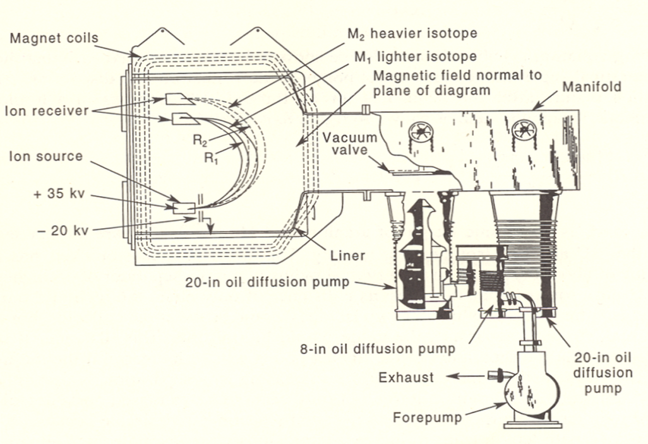
Electromagnetic Isotope Separation (EMIS) (2 of 5)
Calutrons
Essentially mass spectrometers
Ionized uranium atoms subjected to a magnetic field
Radius of curvature different for isotopes of different mass
Used by Manhattan project to produce 80% HEU for Little Boy
Few stages required (high stage separation factor)
But many machines needed for each stage if you want a lot of material
Large electrical power required to power the many electromagnets
Used by Iraq prior to 1991
Calutron cartoon schematic
How about some physics? …

Slide 43
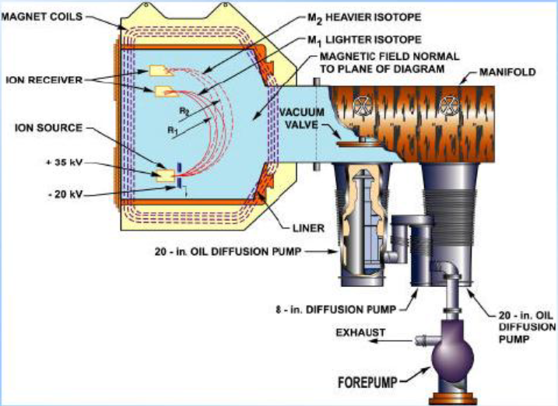
Electromagnetic Isotope Separation (EMIS) (3 of 5)
Heat UCl4 to produce vapor
Bombard with e⁻ to ionize
Accelerate ions and pass through magnetic field
Different mass ions follow different trajectories

Slide 44
Electromagnetic Isotope Separation (EMIS) (4 of 5)
Very energy intensive (even more than gaseous diffusion) and inherently batch in nature
You also need to periodically “tear down” and “clean” the machines
Ionization and collection each batch less than 50% efficient
Wasteful of material without time-consuming recovery operation
Ionization is the least efficient process
Increasing the beam current leads to space charge and separation of the ions which reduces separation
Only two stages required but many elements per stage
Beam current directly impacts both production rate and separation factor
Used at some point by all official NWSs and by Iraq
“Calutrons” names after UC Berkeley where development work was done

Slide 45
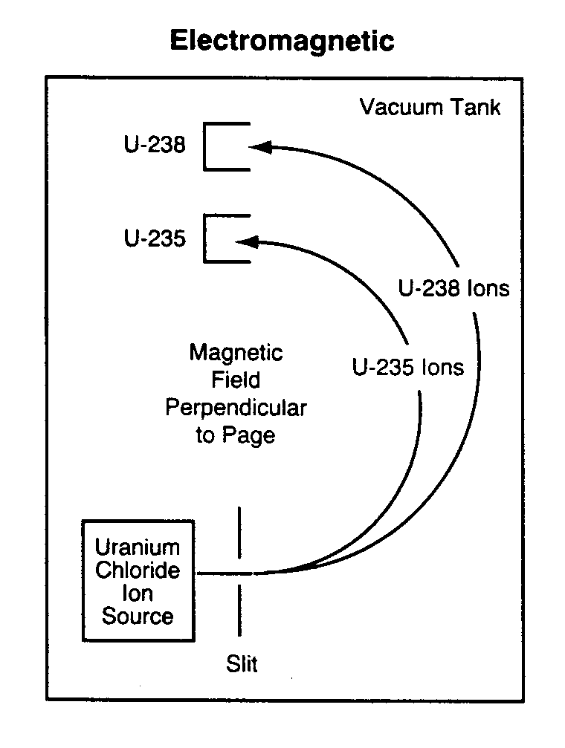
Electromagnetic Isotope Separation (EMIS) (5 of 5)
Calutron Physics
The Lorentz force due to the magnetic field bends the uranium ions into circular paths of radii r according to their masses m.
9
To find ion velocity, apply the work-energy theorem
10
And substituting into
10
9
11
Notes:
Here is the physics and math behind the method.
Again, it is ALL about the physics.
Where does equation (9) come from?
We know Lorentz force, since there is no E-field (once it goes through the slit) simplifies to the magnetic force
We balance the force F = ma = mv²/r with the magnetic force and find…
The radius of a charged particle depends on its mass, velocity, charge, and the B-field
Where does equation (10) come from?
Work-Energy theorem
Energy equal charge times potential difference which equals the kinetic energy of the particle.
From this we can solve for the particle velocity as a function of charge, the voltage drop it passed through, and the mass
Where does equation (11) come from and what does it mean?
With a little bit of algebra, we can find the radius associated with any charged particle of a given mass passing through a voltage drop and then a B-field.
Why don’t we collect the particles at 180 degrees or at 45 or degrees through its rotation?
The particles would be closer together.
Of course, you also have equipment in the way at 180 degrees as well…
You should be able to work through this.

Slide 46
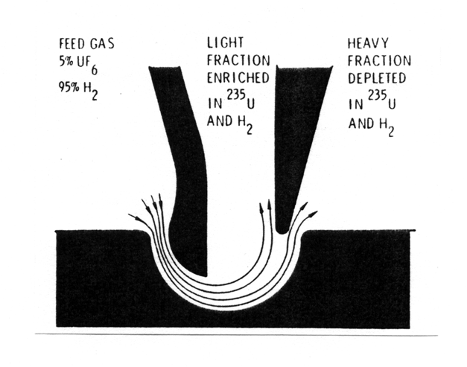
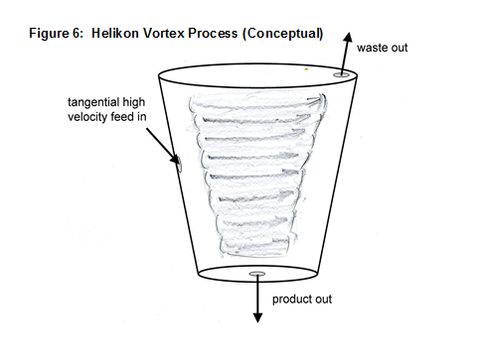
Aerodynamic Separation
Nozzle
UF₆ gas mixed with H₂ and forced through a specially designed nozzle
Centrifugal force separates the molecules lighter and heavier molecules
Used by Brazil for uranium enrichment
Vortex
Same principal as nozzle
Gas is forced into a vortex where the heavier molecules are pushed to the outside
Used by South Africa to produce HEU
General
Separation factors: 1.01 - 1.03
Energy requirements: 4,000 kWh/SWU
Nozzle separation (Kokoski, p.47)
Vortex separation
Notes:
Again, this is all about the physics. I have to give you something to work through on your own so here it is… …but here are a few hints.
Newton will come in handy again here.
The force a particle feels depends on its mass and acceleration. The acceleration depends on v²/r. Obviously changes to v and r will impact separation…
Both techniques offer high stage throughput with reasonable single-stage separation factors.
They are less complex (compare them to centrifuges) so they are a proliferation risk.
The H2 is used to increase the flow velocity of the mixture because it reduces the mean molecular weight which increases the sonic velocity of the gas and minimizes turbulence.
Thus, the carrier gas increases the separation factor significantly
The more massive particles (like in centrifuges) concentrate on the wall (large centrifugal force due to the larger mass of the molecules).
Best separation factors result from maximizing the gas velocity and minimizing the radius of curvature. From basic physics you can see that these both increase the centrifugal acceleration (v^2/r).
Typical parameters are 100 micron (0.01 cm) radius of curvature, feed stream of 0.25 atm pressure, and velocity of 300 m/s which yields a centrifugal acceleration at the wall of about 9 x 10⁸ m/s².
Separation cells are made by etching thin sheets of Ni and stacking them in tandem.
The higher the stack, the more throughput for a given pressure.
These must be operated in cascade.
The auxiliary gas complicates development of the optimum cascade configuration.
The auxiliary gas concentration needs to remain relatively constant throughout the cascade.
The tails are particularly depleted of fill gas (think centrifugal force) so you mix tails from one stage with an H2 enriched feed.
The working gas must be extracted, purified, adjust for the right temperature, and reintroduced at many points in the cascade which increases cost per SWU.

Slide 47
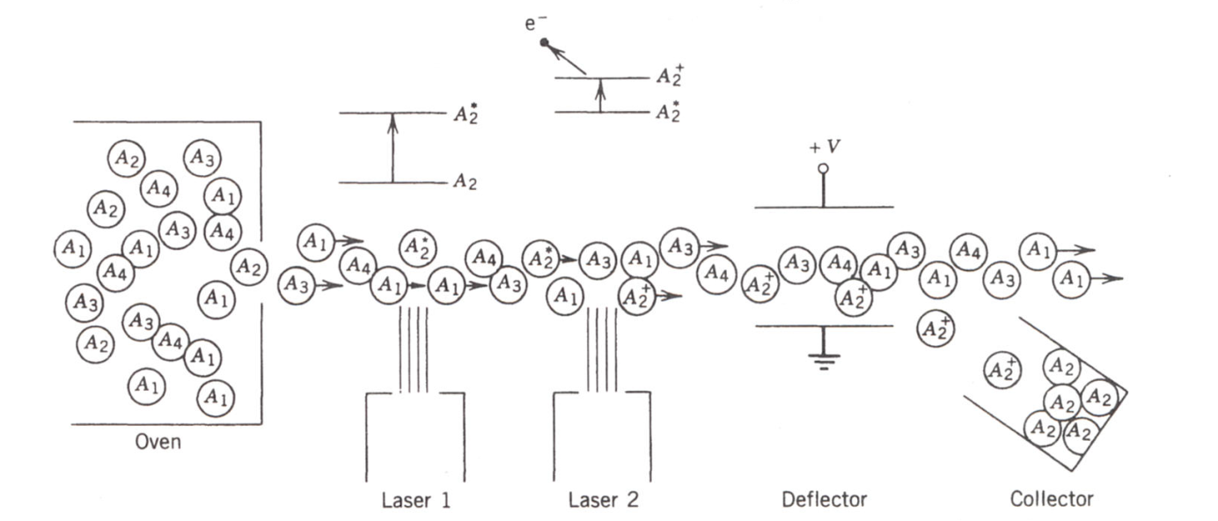
Laser Isotope Separation – General (1 of 5)
General
Three processes have been tried
AVLIS
MLIS
SILEX
Relatively large single stage separation factor (alpha)
Low energy use
The process
Laser 1: promotes electrons to excited state
Laser 2: excited-state electrons are ionized
Positive ions are removed from beam by electric field and collected
UF₆
Laser Isotope Separation (Krane, Introductory Nuclear Physics, p.64)
Notes:
Well, in this case I’d say it’s a little about the physics but very much about the chemistry!
Isotopes (different number of n) have minute effects on the energies of the atomic electrons. These differences are due to differences in the mass, shape, and nuclear spin of the nuclides (charge and current distribution differences within the nucleus!).
In molecules, these differences may change the rotational and vibrational character of the molecule.
Why do you need a very narrow band, tuneable laser for the excitation?
The differences in transition energies due to a change in the isotopic character are normally much smaller than the magnitude of the transition (level widths are much smaller than the energy differences for a transition).
In order to take advantage of these minute differences, you need a very narrow energy tunable laser.
General concept:
(1) Isotopic differences exist.
(2) Use a tuneable laser to selectively excite one isotope or molecule.
(3) Use a second laser to ionize the excited isotope or molecule.
(4) Use an E-field to separate and collect the ions from the gas drifting through.
Three major classes of LIS:
photochemical—excited atom or molecule has a higher chemical reactivity that a similar species in its groud state and will reacter preferentially with a suitable partner
atomic photoionization—an excited atom will be more easily ionized by a second photon of a suitable energy
photodissociation—an excited molecule can be more easily disassociated than when in the ground state.
While LIS competes with other enrichment techniques, it is not very efficient.
The single-stage separation factor for LIS depends on delivered laser power (which impacts throughput) and frequency quality (which impacts selectivity).
Reactor fuel composition can be made in a single pass.
This method is very technical.

Slide 48
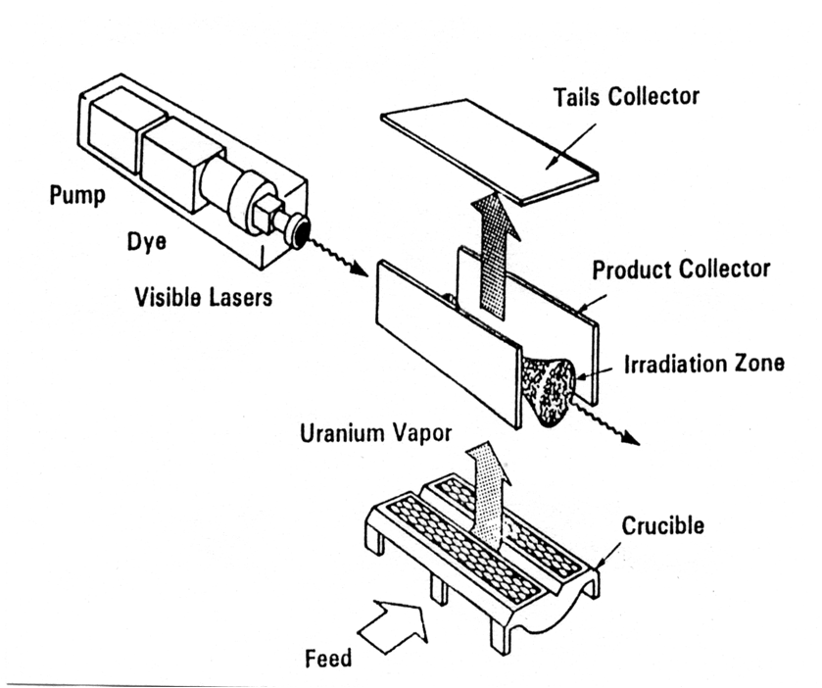
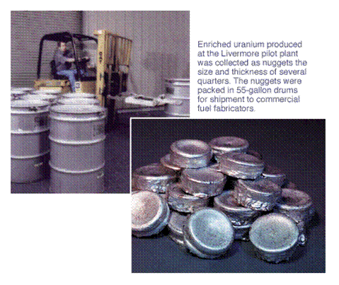
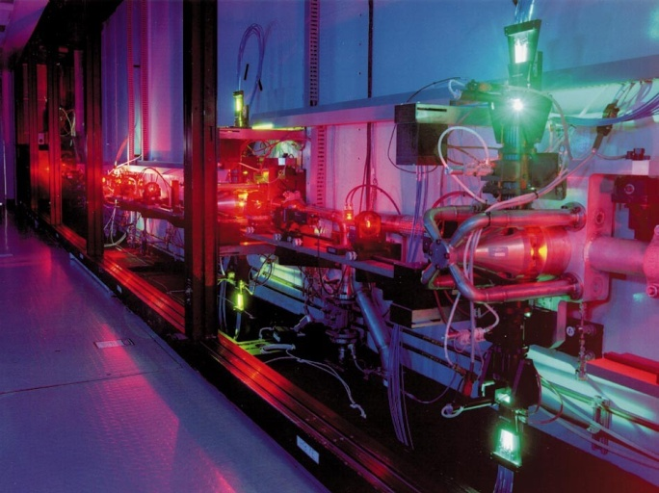
Laser Isotope Separation – AVLIS Atomic Vapor Laser Isotope Separation (2 of 5)
Developed by LLNL in 1990s (https://www.llnl.gov/str/Hargrove.html)
One laser optically pumps a separate dye laser
Dye master oscillator lasers provide precise frequency control
Ionization levels of ²³⁵U and ²³⁸U differ by one part in a million
AVLIS Schematic (Knief, Nuc. Engr., p.529)
Notes:
The atomic vapor of U atoms must be produced from a metal
This is a significant technical problem due to the low volatility and high chemical reactivity of U and the high temperatures needed to produce significant vapor pressure.
Liquid U is very reactive so finding a container for it is extremely difficult.
In practice, U vapor is produced with an electron beam, creating a molten area of limited extent in a U ingot which acts as its own container.
The vapor is then irradiated by several lasers.
It takes about 6.2 eV to remove an electron from the U atom.
EM deflection is used to select ionized 235U atoms from 238U atoms and is collected on plates. (Nonionic tails condense somewhere else.)

Slide 49
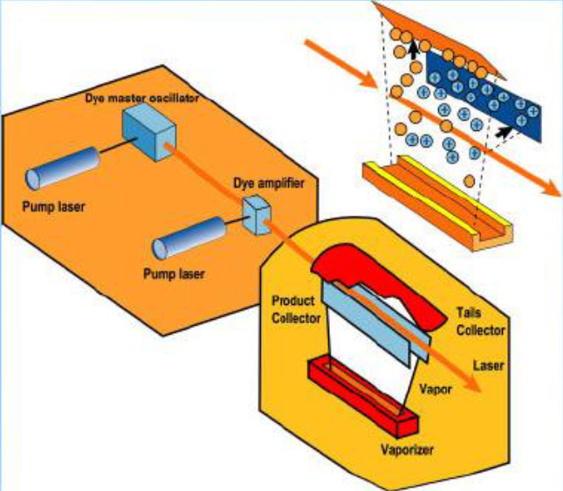

Laser Isotope Separation – AVLIS (3 of 5)

Slide 50
Laser Isotope Separation – MLIS (4 of 5)
Developed by LANL in 1970s (http://www.fas.org/nuke/intro/nuke/uranium.html)
Two lasers used to irradiate UF₆
First laser (CO₂ infrared) operating near 16 µm excites more ²³⁵U than ²³⁸U
Ideally, a second laser (XeCl ultraviolet) strips one fluorine from the excited UF₆ producing UF₅ which precipitates out of the gas stream as a power
Flourine atom is added to create UF6 and mixture re-staged
Challenge – No known MLIS optics can handle both infrared and ultraviolet wavelengths
Primary Advantage – UF₆ as a feed material (rather than vaporized U)
CO₂ LASER
10.6 µm
BEAM CONVERTER
16 µm
16 µm
²³⁵UF₅
²³⁵UF₆
F
UF₆
XeCl LASER
308 nm
²³⁸UF₆
Notes:
235UF6 molecules absorb energy from IR lasers while 238UF6 molecules are unaffected.
Energy is introduced to the 235UF6 molecule (in steps) so it dissociates to 235UF5 + F
UF5 condenses into a fine powder called “laser snow” which is filtered from the UF6 tails.
Unlike AVLIS, MLIS does not have the difficulty of producing a concentrated atomic laser. However, MLIS performance is degraded by molecular motion.
At normal temperatures, UF6 collisions lead to a wide range of vibrational excitations and the random molecular motions negate the selectivity of the laser.
This problem is overcome by diluting UF6 with a carrier gas (e.g. Argon) and letting it expand through a nozzle into a vacuum. This results in a beam of “cold” UF6 moleculs travelling in the same direction and is a more suitable target for the MLIS lasers.

Slide 51

Laser Isotope Separation – SILEX Separation of Isotopes by Laser Excitation (5 of 5)
Technology developed by Australia in 1990s
Variation of MLIS (http://library.lanl.gov/cgi-bin/getfile?00937128.pdf)
Proprietary compound chemically reacts with laser-excited ²³⁵UF₆ molecules
Single stage separation factor α = 2 - 20 (unclassified)
A little history …
1996: The US Enrichment Corporation (USEC) secured rights to evaluate and develop SILEX for commercial uranium enrichement
2003: USEC signed an agreement with GE, granting exclusive rights to develop SILEX enrichment technology
2008: Test loop began operation at GE's nuclear (fuel fabrication) facility in Wilmington, North Carolina
2009: License submitted to NRC for full commercial plant at Wilmington
2013: Lead cascade scheduled for completion with “significant production capability”
SILEX Plant in Wilmington, NC

Slide 52
Chemical Separation (1 of 2)
Both France and Japan have developed (different) chemical process for separating uranium isotopes
Details regarding the processes are maintained by the governments of each nation
In general, ²³⁵U and ²³⁸U in compound show different preference for different valance forms
Japan – Asahi ion-exchange process
Hexavalent (U⁶⁺) uranyl chloride UO₂Cl₂ is mixed with tetravalent (U⁴⁺) uranium tetrachloride UCl₄
²³⁵U shows a preference for the higher valance and will exchange with ²³⁸U when mixed in a reaction column
Requires a proprietary resin
Limited by the mixing times of reagents and resin
A catalyst increases the exchange process
Notes:
Methods are designed to capitalize on the tendencies of different isotopes to concentrate in selected molecules when the atoms of that element can exchange between molecules.
Chemical-exchange enrichment cells involve repeated extraction and back-extraction of U compounds in solution (or adsorbing and desorbing from a solid support)
Criticality safety is a big concern during the later stages of generating HEU.
To prevent criticality accidents, the mass of HEU at any given location must be maintained below a critical amount.
It should be noted that the “critical mass” depends on the chemical form, density, geometric configuration, and the environment (i.e. the presence of neutron reflectors or moderators)

Slide 53
Chemical Separation (2 of 2)
France – Chemex solvent-extraction process
Uses trivalent (U³⁺) and tetravalent (U⁴⁺) forms of some compound
²³⁸U concentrates in the U³⁺ form, and ²³⁵U in the U⁴⁺ form
No catalyst used
Impurities must be avoided
Low separation factor – 1000s of stages needed just to LEU, but a single column contains hundreds of effective stages
France has offered to license process to other nations if they agree not to pursue any other separation process(es)
Because the use of Chemex to LEU would make it easier for other processes to go to HEU

Slide 54

Solid Uranium Hazards – ORNL Accident
AVLIS, EMIS, and Chemical Separation involve solid uranium metal or uranium compounds
June 16, 1958 criticality accident
Flow to two (top) uranyl nitrate storage tanks turned off for cleaning
Leak in valve leading to 55-gallon drum caused accumulation of 2.1 kg of enriched (93%) uranium in form of liquid uranyl nitrate
Water from top two tanks flushed to 55-gallon drum; water provided adequate moderation for criticality
8 technicians injured
Doses of 29-461 rem received
Slight area contamination
Contamination costs < $1000
Accidents can serve as a proliferation signal
Extra-national medical assistance
Assistance for decontamination and clean up

Slide 55
Enrichment Processes Compared
Process | # of Stages | # of Equipment Units | Equilibrium Time
Gas Centrifuge | < 60 | Thousands | Hours
Gaseous Diffusion | 3500-4000 | 3500-4000 | Months
Chemical Exchange | 5000-6000 | 10s of columns | Year or more
Ion Exchange | 12000-16000 | 10s of columns | Months
Laser | <10 | <10 | Hours
EMIS | 2 | Hundreds to Thousands | Weeks

Slide 56
Summary of Uranium Enrichment Methods
Notes:
Now that we’ve looked at the various enrichment techniques, you should have a better understanding of why the numbers are what they are…

Slide 57
Summary
Methods of Uranium Enrichment
Preferred method is centrifuge
Many methods use uranium hexafluoride (hex)
The Isotope Enrichment Stage
A stage may be a single unit or many units in parallel
Most processes involve small amounts of stage enrichment
Many stages in series are often necessary
Isotope Enrichment Cascades – many stages in series
Separative Work
Physical effort needed to reach a certain level of enrichment
Affects cost of enrichment
The effort to reach enrichment (SWU) does not change, but the amount of separative work that a method produces changes
“The real product of an isotope-separation plant is separative work, not enriched uranium.”
– D.R. Olander, “The gas centrifuge”, Scientific American, 239(2), 1978

Slide 58
Do you understand? Can you explain? Can you estimate?
(1) Can you name and describe the methods of Uranium enrichment?
(2) Why is UF6 so frequently used for enrichment processes?
(3) Can you work through isotope enrichment?
(4) What is the single stage separation factor, alpha?
(5) How is the “waste” from a stage reintroduced into the isotope enrichment cascade?
(6) Can you work through the isotope enrichment cascade problem?
(7) How do the separation factors compare for gaseous diffusion, gas centrifuge, and laser processes compare?
(8) What is a SWU? (Define it.)
(9) How many SWU are needed to produce a gun type weapon (implosion type weapon) in one year?

Slide 59
Do you understand? Can you explain? Can you estimate?
(10) Can you explain the diffusion physics behind the gaseous diffusion process?
(11) Can you derive “alpha” for gaseous diffusion?
(12) Can you explain the physics behind the gaseous centrifuge?
(13) Do you understand the relationship between the rotation rate of a gaseous centrifuge and its separation factor?
(14) Can you explain the physics behind thermal diffusion?
(15) Can you explain the physics behind EMIS?
(16) Can you explain the physics behind aerodynamic separation?
(17) Can you (generally) explain the chemistry behind chemical separation processes?
(18) Can you explain the physics behind laser isotope separation?

